Slide 1
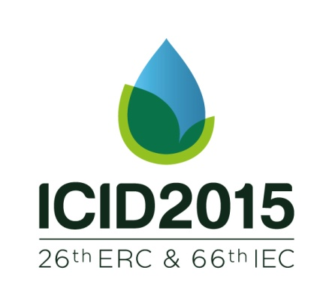
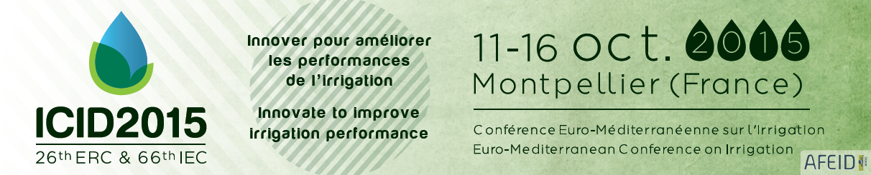
Author :
Hanugrah Purwadi (hanugrahpurwadi@yahoo.com)
Agus Suprapto K (agus_s_k@yahoo.com)
Vicky Ariyanti (vicky_ariyanti@yahoo.com)
Utilization of Urbanized Waste Water for Irrigation
Case : Wadaslintang Irrigation Area (31,853 Ha), Central Java, Indonesia

Slide 2
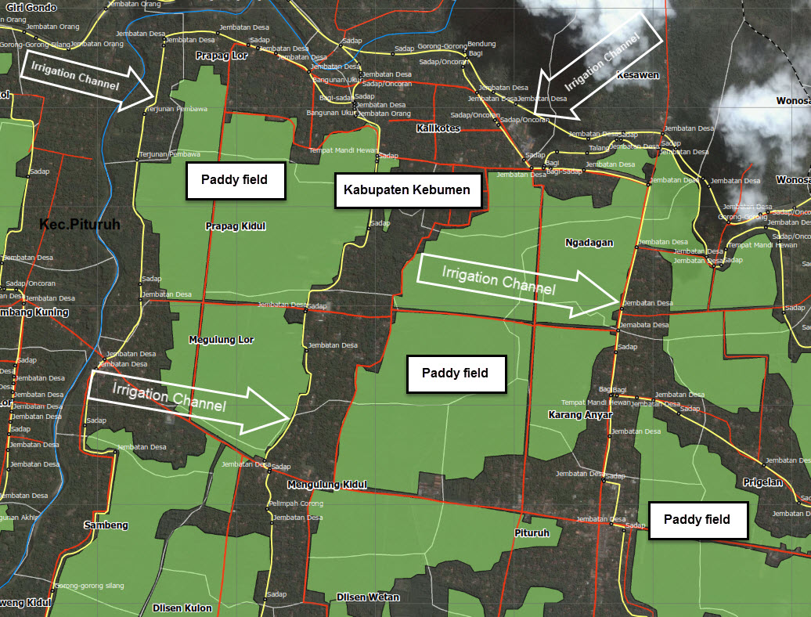
Presentation outlines
1. Introduction
2. Hydrologies Condition and Irrigation Water Supply / Demand
3. Waste water in Irrigation Channels
4. Efforts to Use Waste Water for Irrigation
5. Conclusions and Recommendations

Slide 3
Introduction
In Wadaslintang area water use as an essential role in food and many amenities supplies such as : sanitation, irrigation, drinking water etc
Population and water demand for several necessities are aggravating water shortage
Irrigation water use faces severe competition from non-agricultural users mostly relative with environmental impacts
Require integrated management in implementation for water available particularly when agricultural sector is more dominant in demand for water

Slide 4
Hydrologies Condition and Irrigation Supply / Demand (1)
The average annual precipitation over Wadaslintang catchment area reaches to above 3.700mm/year but occasionally to below 1.500 mm/year, while the average is approximately 2100 mm/year
For last nine years the annual precipitation tends to decrease

Slide 5
Hydrologies Condition and Irrigation Supply / Demand (2)
Compositions for cropping pattern seasons were divided into 3 type with paddy type dominantly in this area..
During periods of decreased rainfall the need for irrigation water becomes more urgent. This irrigation water is crucial for crop growth to overcome dry periods
Infrastructure degradation and sub-optimum control of the irrigation works also resulted in large water deficits for the agriculture and worse water quality
Furthermore, during low water availability the government proposed the combination of the measures ‘irrigation efficiency with community participatory ’

Slide 6
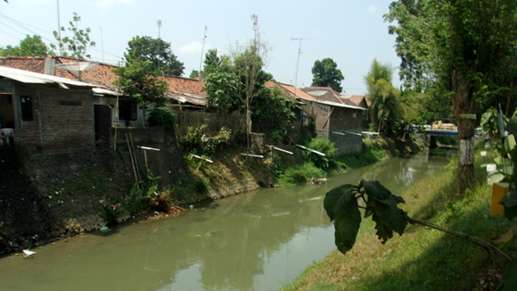
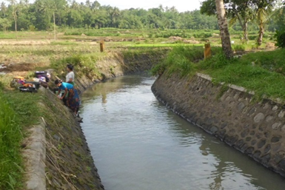
Waste water in Irrigation Channel
The growing water scarcity is intensified by the competition from non-agricultural users and environmental consequences of irrigation,
This situation can be explained by the expected conversion of agricultural land into residential area

Slide 7
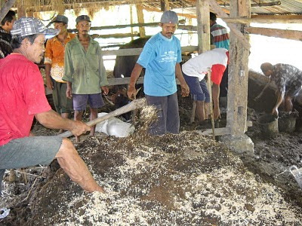
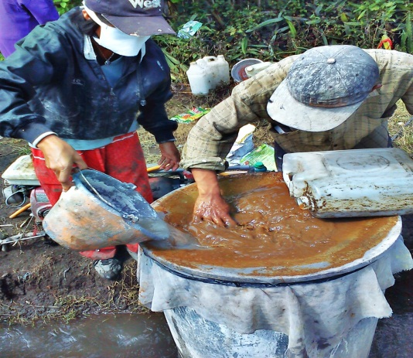
Effort to Use Waste Water
To obtain possible measure of crop production, farmers use specify organic fertilizer, which accommodate cropping type in each season and duration of the growing period for each crop
The quality of the irrigation channels will be achieved by regulate timely irrigation combining with repairing leakages, dredging sediment and other construction effort.
Increasing the transport irrigation efficiency by maintenance and rehabilitation the primary, secondary and tertiary irrigation channel has done with farmers Association (GP3A) in cooperation with local government.

Slide 8
Conclusions and Recommendations
To obtain possible measure of crop production farmers use specific organic fertilizer, which accommodate cropping pattern type in each season and duration of the growing period for each crop.
It is recommended to manage run off on site to ensure surface water do not become too contaminated by any flow from urban areas also to use diversion channels to prevent all uncontaminated water from entering the irrigation area, especially at the end of the wet season

Slide 9

Terima kasih
Thank you

