Slide 1
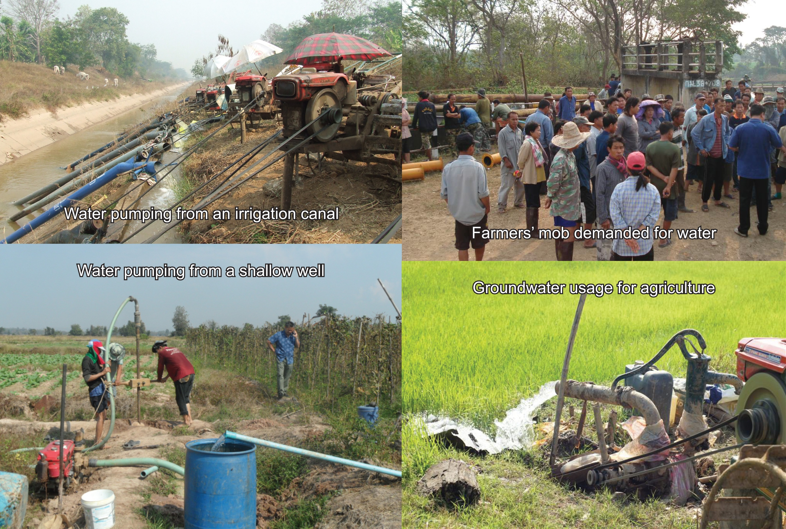
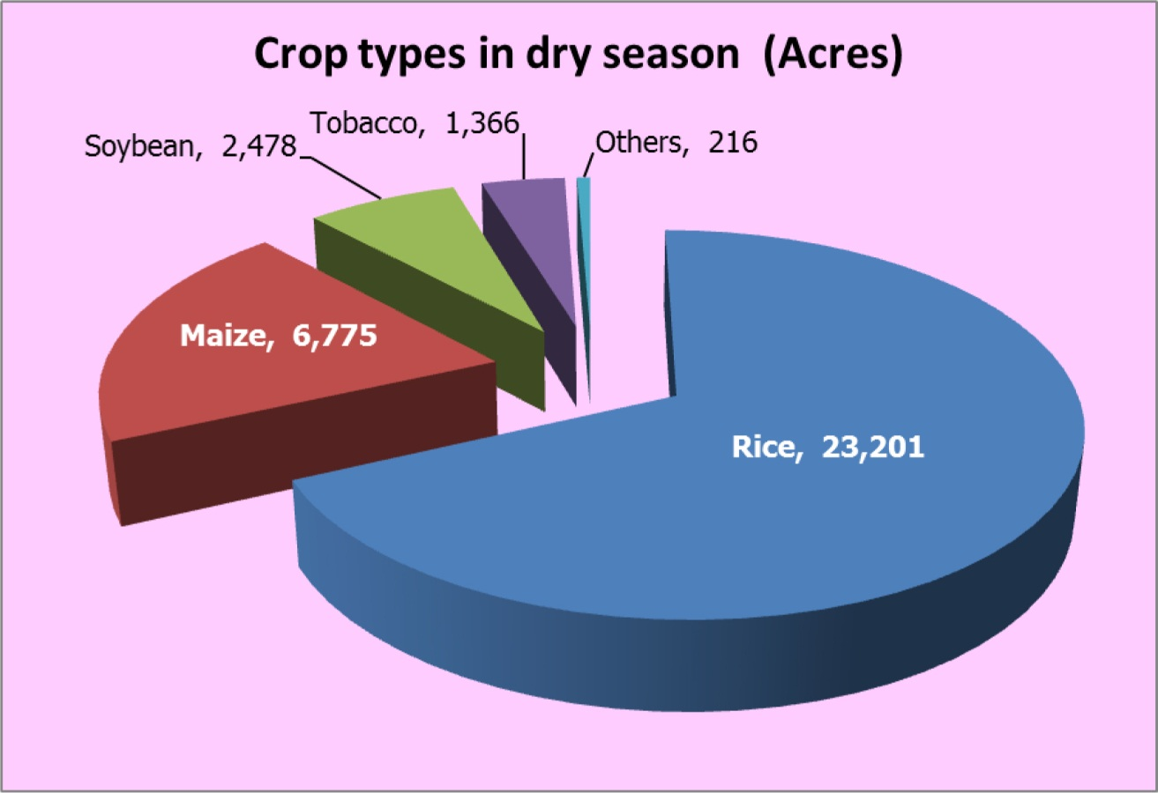
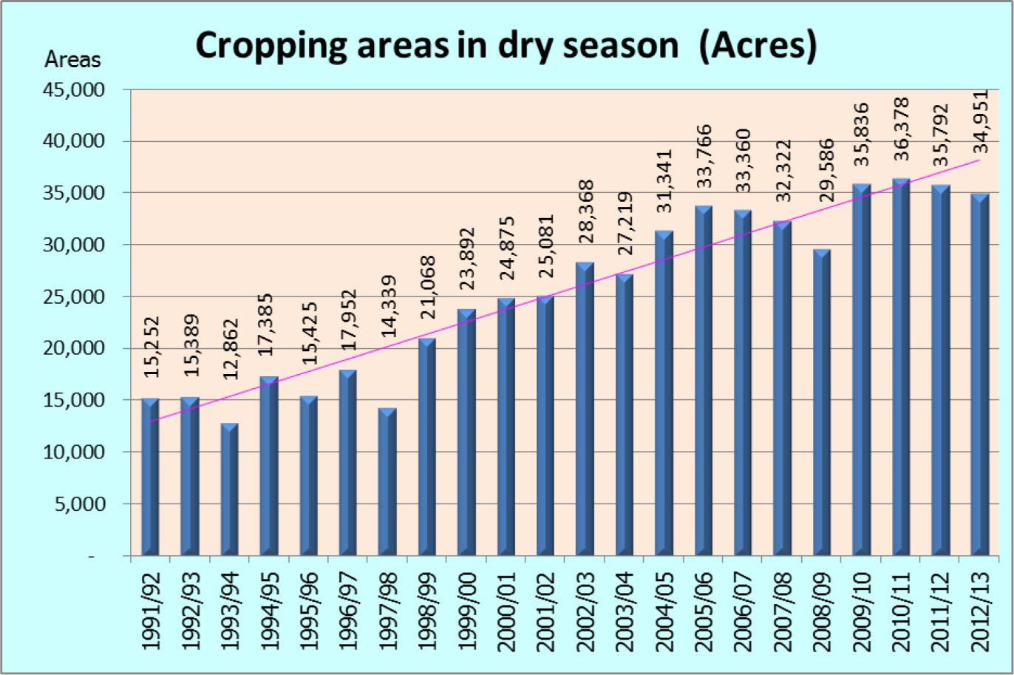
Local initiative for integrated governance of
surface water and groundwater
Atthapong Chantanumate, Royal Irrigation Department, Thailand, atpongc@hotmail.com
Wachiraporn Kumnerdpet, Royal Irrigation Department, Thailand, indianroller@hotmail.com
Methee Wutthicharoen, Royal Irrigation Department, Thailand, tock25156@hotmail.com
Background
The Mae Yom Operation and Maintenance Office was established to manage water from a weir. The weir supplies water for the irrigation areas of 89,000 acres in a rainy season and only 7,000 acres in a dry season, covering 6 districts and 158 villages. During a rainy season (May-November), the average maximum flow of the Yom River is 1,042 m³/sec or daily runoff of 90 million m³, compared to 3 m³/sec or daily runoff of 0.26 million m³ in a dry season (November-April). Water shortage usually occurred in a dry season because water requirement of farmers was 36,000 acres.
Due to insufficient supply of surface water, farmers then needed to seek additional water from shallow wells for agriculture of 29,000 acres. More than 2,600 shallow wells were pumped around 800 – 2,000 m³/acre/cropping season. Water level in those shallow wells was getting low or dried up. In 2003, cropping areas about 2,800 acres were damaged and yielded only 1,300 - 1,500 kg/acre (normal yield 2,000 - 2,500 kg/acre) because of water shortage.
Repeated drought leaded to farmer’s poverty and divided family because of crop damage and seasonal labor migration. The seasonal labor migration of farmers caused unhealthy family relationship, thus exposing to social problems e.g. depression, and drug addict.
Concept of the initiative
Incorporating local wisdom and different learning aspects through stakeholders participation has become an ultimate initiative called three-coherent task mechanisms as the followings:
The first task, water provision for agriculture, involves integration of related public agencies, that is, the Royal Irrigation Department (RID), local administrative organizations, the Provincial Disaster Relief Committee (PDRC), and provincial agricultural officers, to solve drought problems. Main activities are: to provide mobile pumps and to establish a water-management coordination center by the RID; and, to allocate budgets on fuel and electricity cost for pumping by the PDRC.
The second task, participatory irrigation management, includes joint-specifying rotational water delivery plan between farmers and responsible public agencies; setting agreed rules on water delivery among water users; building temporary weirs along tributaries by volunteers; installing pumps in an area; and, improving water management approach to firstly deliver water to tail-end canals and then to head-end canals.
The third task, acting upon agreement and supervision, promotes transparency in water governance by involving the public, i.e. farmers and water user groups, to investigate whether the rotational water delivery based on planning and to inspect the use of budgets on fuel and electricity cost for pumping.
The three-coherent task mechanisms have been implemented since 2005. At present, the mechanisms turn to be parts of routine jobs of relevant public agencies in order to mitigate drought for farmers.
Benefits of the initiative
This initiative assisted to supply water for agriculture throughout a dry season from 7,000 acres to 36,000 acres in 2010. The farming plots at least 27,000 acres are not necessarily to pump water from shallow wells. However, the rest farming plots of 9,000 acres still use water from shallow wells. The initiative is able to maximize the use of surface water for agriculture according to the agreed rules. The initiative, moreover, helps reduce groundwater usage, of which maintains groundwater level in shallow wells for future activities.
Style “ICID 2015 Title level 3” (Arial, 28pt, bold)
Style « ICID 2015 text » (Arial, 24pt). text text text text text text text text text text text text text text text text text text text text text text text text text text text text text text text text text text text text
Resulting from the initiative, farmers gain more income, from 5 million USD to 18 million USD, by selling agricultural products. Water fights among farmers is decreased. Destruction of irrigation structures has been minimized. The seasonal labor migration of farmers is also reduced which brings better quality of life to farmers and lower social problems to locality.
Another key consequence of groundwater usage is ground subsidence. Before the initiative, the ground subsidence was common in this area. After implementing the initiative, integrated governance of surface water and groundwater, the trend of ground subsidence has been noticeably declined.
Usage of surface water and groundwater in dry season agricultural areas: Background:
Cropping areas and crop types in dry season: Benefits of the initiative:

