Slide 1
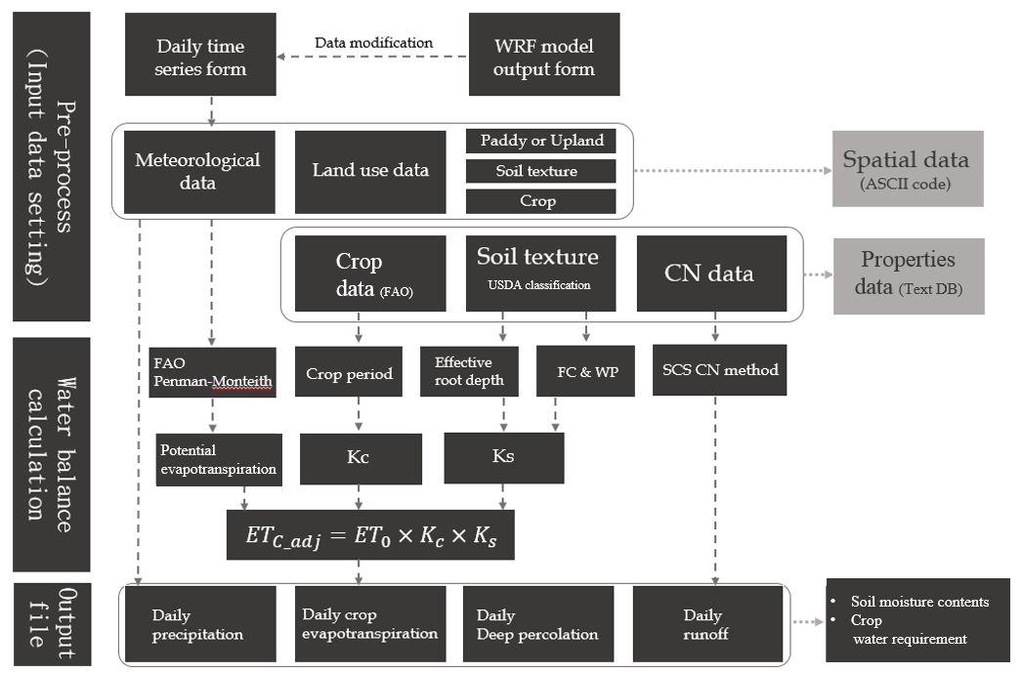
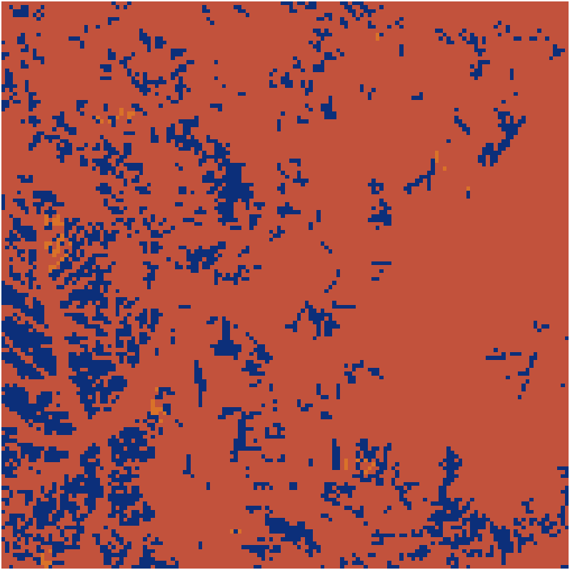
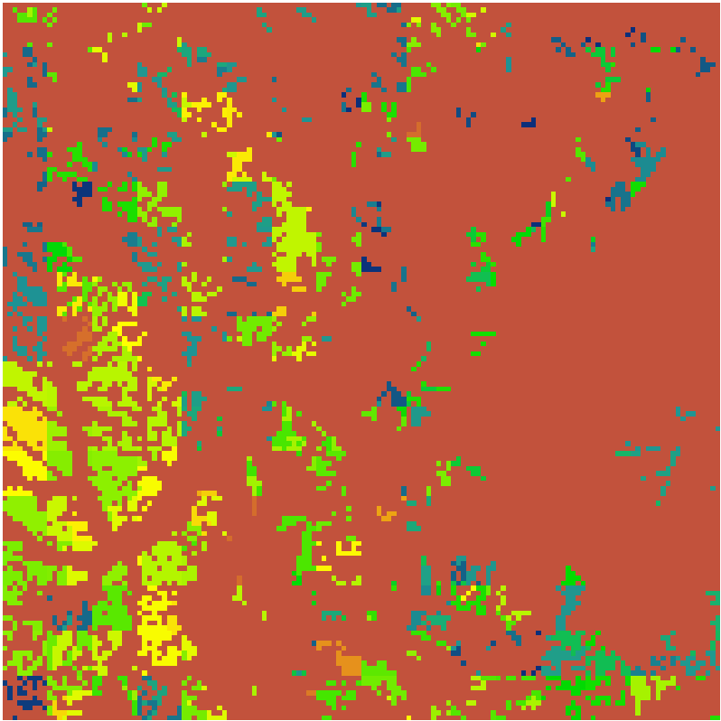
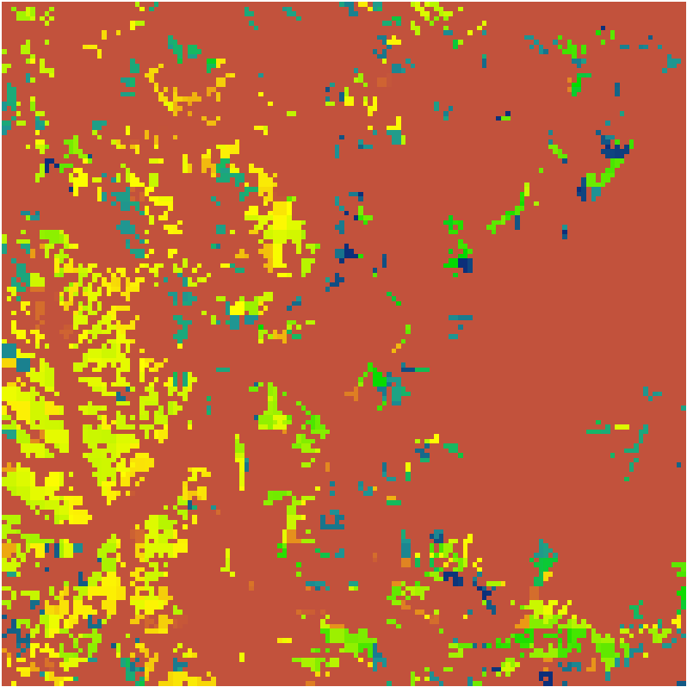
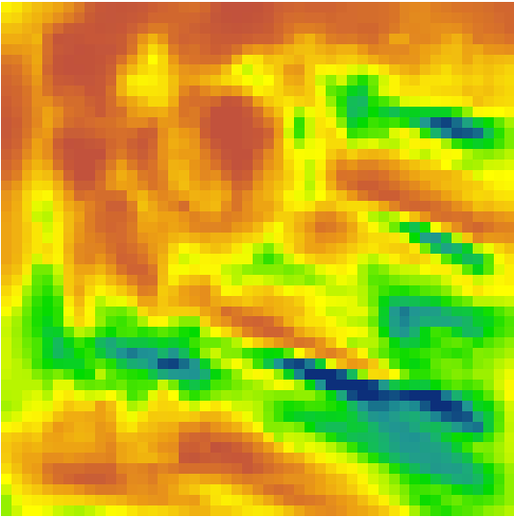
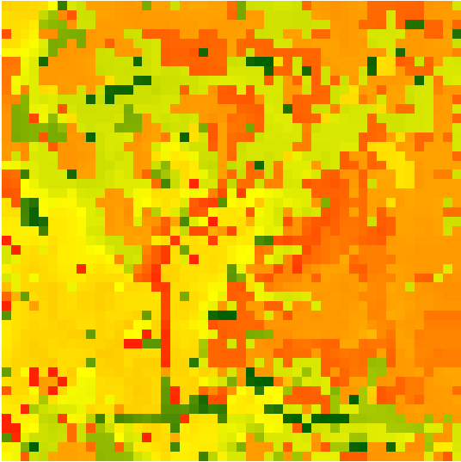
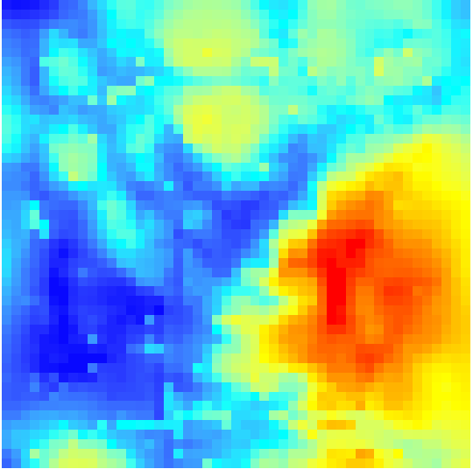
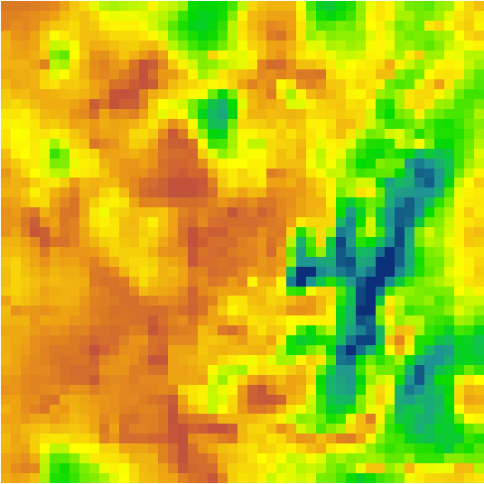
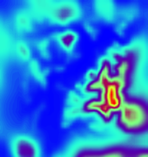
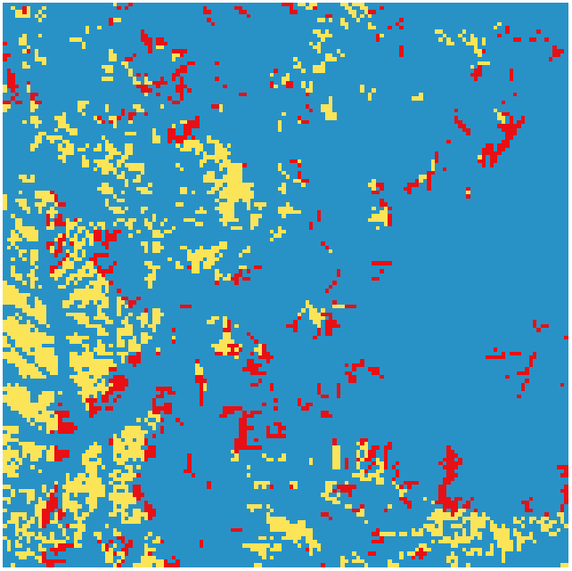
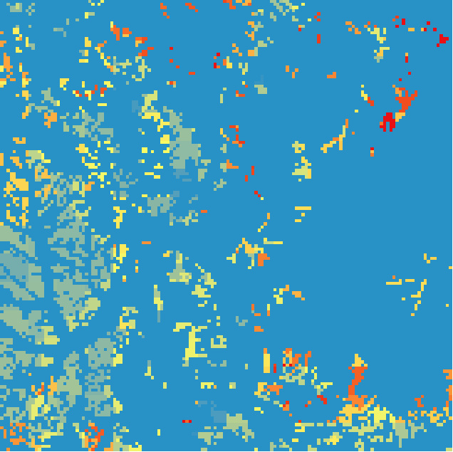
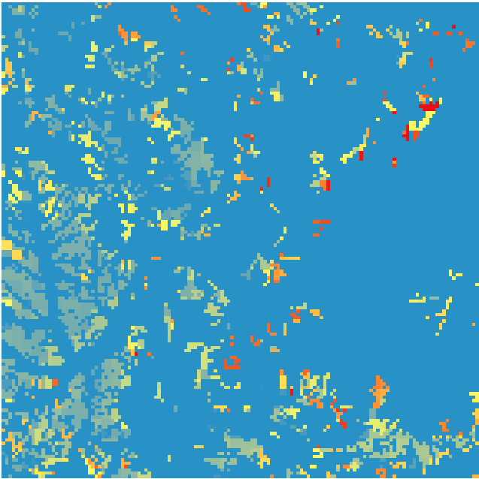
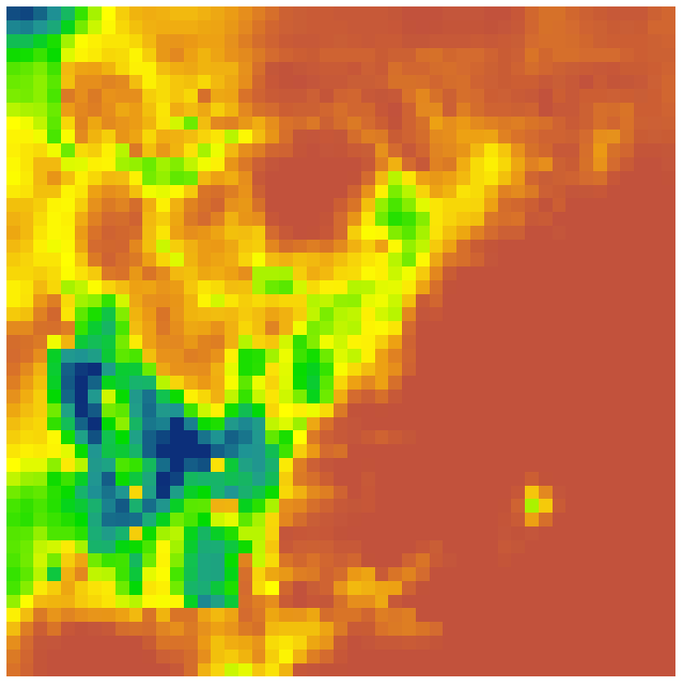
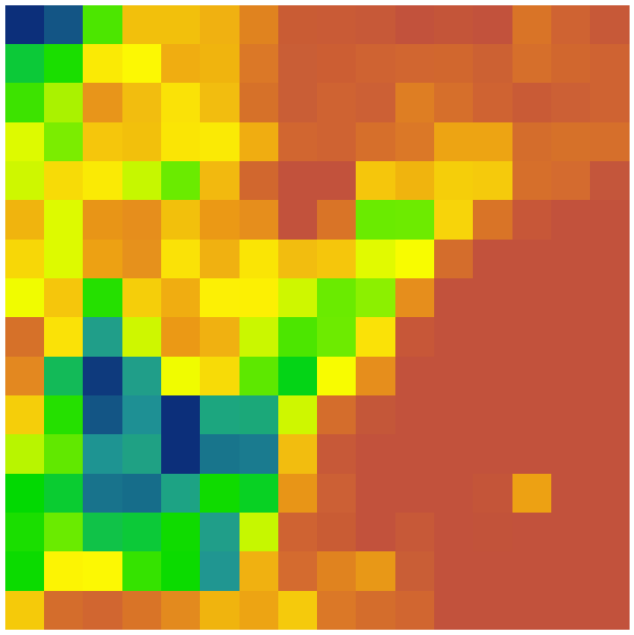
Evaluation for the application of WRF meteorological data on grid-based soil moisture model in upland
Min-ki Hong, Seoul National University, alsrl159@snu.ac.kr
Sang-hyun Lee, Texas A&M, sanghyun@tamu.edu
Seung-jae Lee, National Center of Agro Meteorology, sjlee@ncam.kr
Sung-hack Lee, Seoul National University, hacktan@snu.ac.kr
Jin-yong Choi, Seoul National University, iamchoi@snu.ac.kr
Abstract
It is crucial to aware the water condition of crop and soil for designing proper irrigation scheduling on upland irrigation system operation. In this study, the irrigation factors which are evapotranspiration, soil moisture contents and irrigation water demand were assessed by the spatially distributed soil moisture model using enhanced meteorological data. This enhanced meteorological data is derived from WRF(Weather Research and Forecast) model. The meteorological data are applied to this model in 3 cases. Three different cases of meteorological data are 270m, 810m in square which is from WRF model and data from nearest weather station respectively, and also 90m input data for, soil-texture and land-use data were prepared. For applicability assessment, comparative analysis among the results of each meteorological data application was conducted. As a result, in each case of meteorological data, the irrigation factors of each soil elements are estimated and from utilizing the different spatial resolution weather data, it provided the spatial distributions of evapotranspiration and soil moisture about time and space, and the irrigation factors are used to estimate irrigation water requirements in experimental site during the cropping period. Consequently, the availability of enhanced meteorological data for soil water-balance analysis was evaluated and the proper grid size of WRF meteorological data was analysed.
Introduction
Materials and Method
WRF model
Mesoscale numerical weather prediction system
Maximum 10 days forecasting possible
Resolutions range from tens of meters to thousands of kilometers
Generation of atmospheric simulations using observed data
Grid-based soil water balance model
Style « ICID 2015 text » (Arial, 24pt). text text text text text text text text text text text text text text text text text text text text text text text text text text text text text text text text text text text text
Results
Demonstrative application
Results of evapotranspiration estimation
Results of Irrigation water requirement(IWR) estimation
Overall estimation process of Grid-based soil moisture model
Necessity of utilizing enhanced meteorological data to analyze soil water balance in agricultural land
• Forecasting the future hydro-meteorological information using enhanced meteorological data
• Discordance between the meteorological data of near weather station and cropping site
Necessity for water balance model associated with enhanced meteorological data
• Soil moisture modeling in grid-based
• Reflection of the on-site weather condition
Application enhanced meteorological data to a grid-based soil moisture model
Comparison of Results of evapotranspiration estimation
Thiessen
810m X 810m
270m X 270m
WRF meteorological data (2014. 09. 10 12am)
Grid number/size :
3,449/8,100$m^{2}$
Total evapotranspiration amount :
241,461$mm$/20day
Average evapotranspiration amount :
70.01$mm$/20 day
Grid number/size :
3,449/8,100$m^{2}$
Total evapotranspiration amount :
258,005$mm$/20day
Average evapotranspiration amount :
74.81$mm$/20day
Grid number/size :
3,449/8,100$m^{2}$
Total evapotranspiration amount :
240,847$mm$/20day
Average evapotranspiration amount :
69.83$mm$/20day
Daily
Accumulated Precipitation
Daily
Averaged
Net radiation
Daily
Averaged
Temperature
Daily
Averaged
Wind speed
Daily
Averaged
Relative
Humidity
Regional
Elevation
Comparison of Results of evapotranspiration estimation
Thiessen
810m X 810m
270m X 270m
Comparison of WRF meteorological data (Precipitation)
Grid number/size :
3,449/8,100$m^{2}$
Total IWR amount :
$19,707mm$/20day
Average IWR amount :
$6.33mm$/20 day
Grid number/size :
3,449/8,100$m^{2}$
Total IWR amount :
$83,949mm$/20day
Average IWR amount :
3$7.56mm$/20day
Grid number/size :
3,449/8,100$m^{2}$
Total IWR amount :
$68,778mm$/20day
Average IWR amount :
$19.94mm$/20day
Discussions
Water balance estimation results from high resolution meteorological data reflects spatial variances of study area
- Irrigation scheduling by agricultural regions is possible
Water balance estimations using WRF meteorological data show spatial distributions of soil and water condition such as evapotranspiration and irrigation water requirement
These estimation results will be verified by observed data(soil moisture content, evapotranspiration) and soil moisture model also will be calibrated further
Resolution
270m X 270m
Resolution
810m X 810m
Grid-based soil moisture model
Each upland region is latticed
Form to be linked with enhanced meteorological data
Each grid has its own simulation according to its land-use, soil texture, and meteorological data

