Slide 1
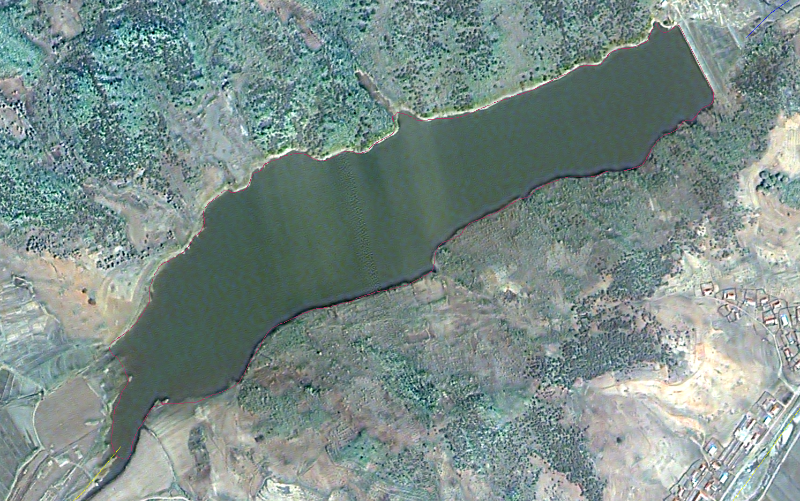
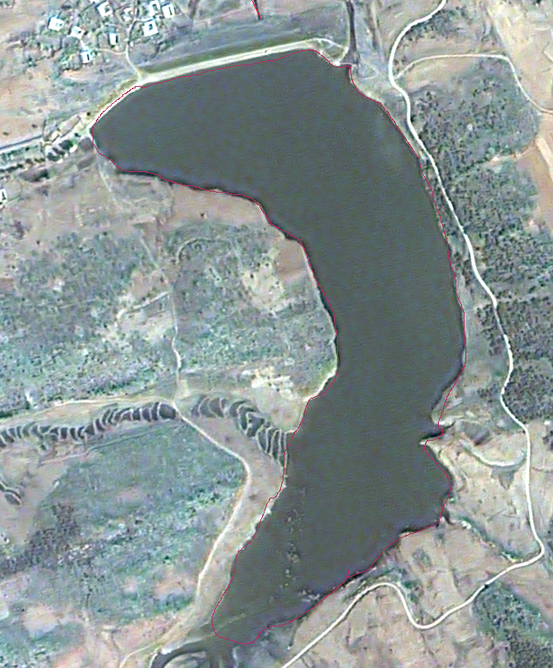
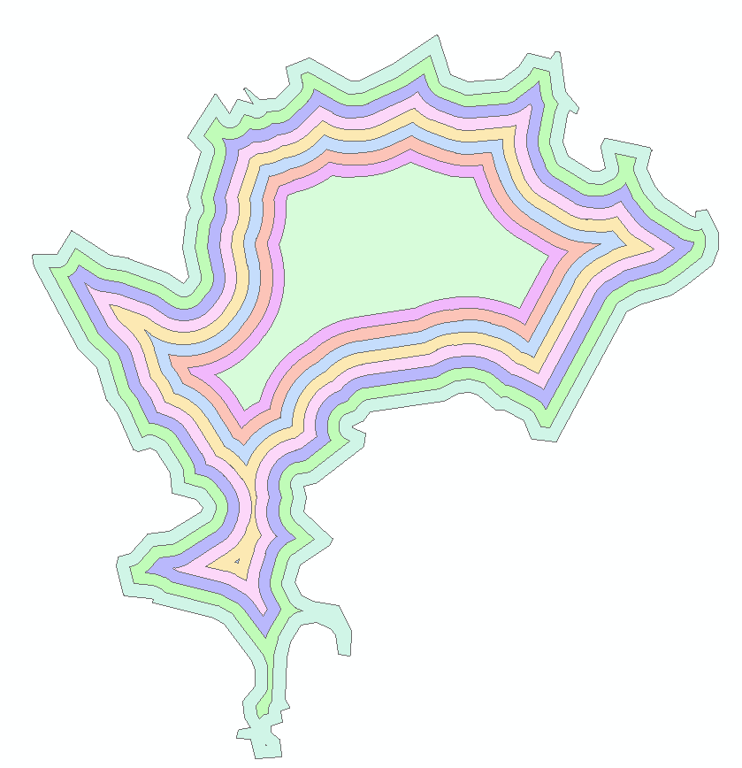
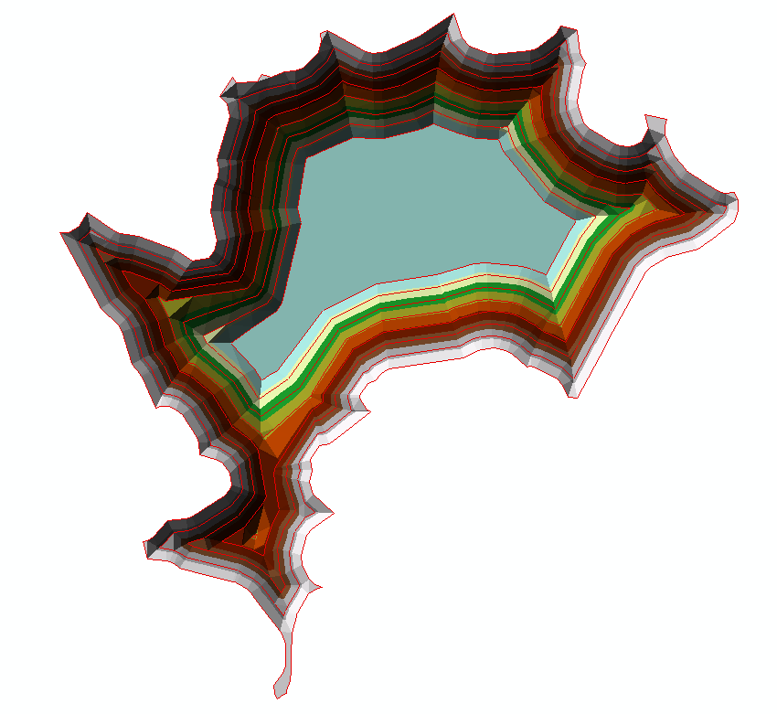
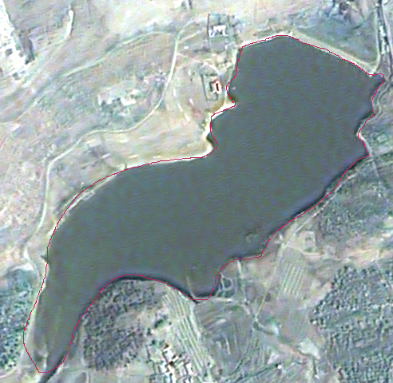
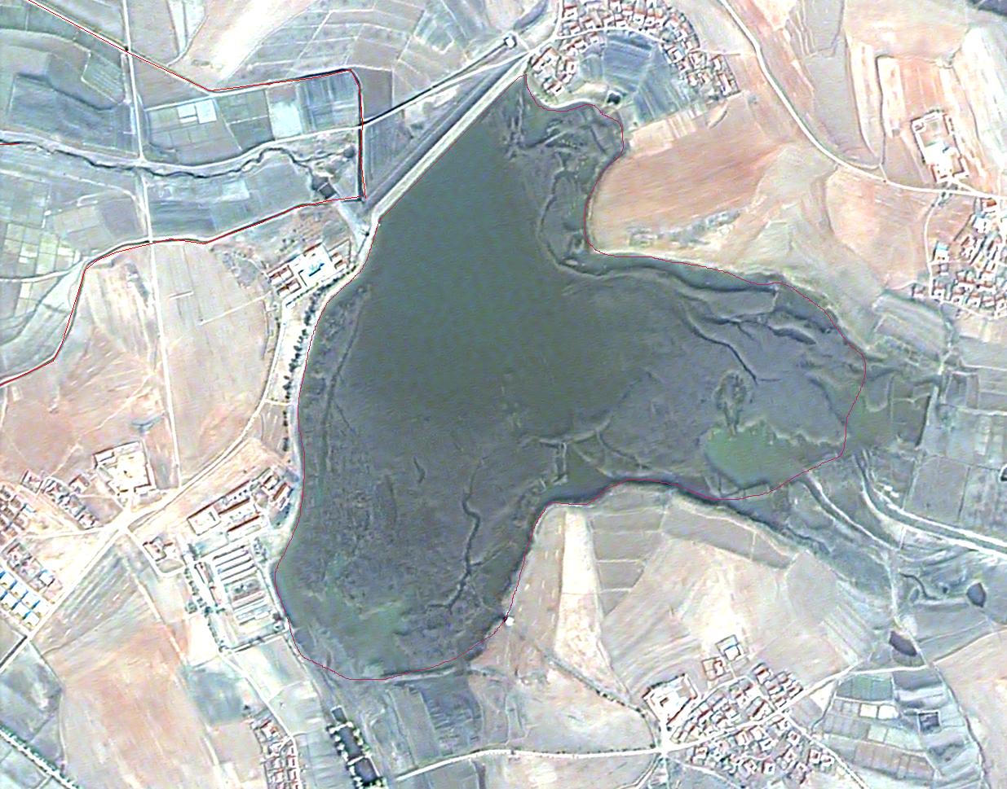
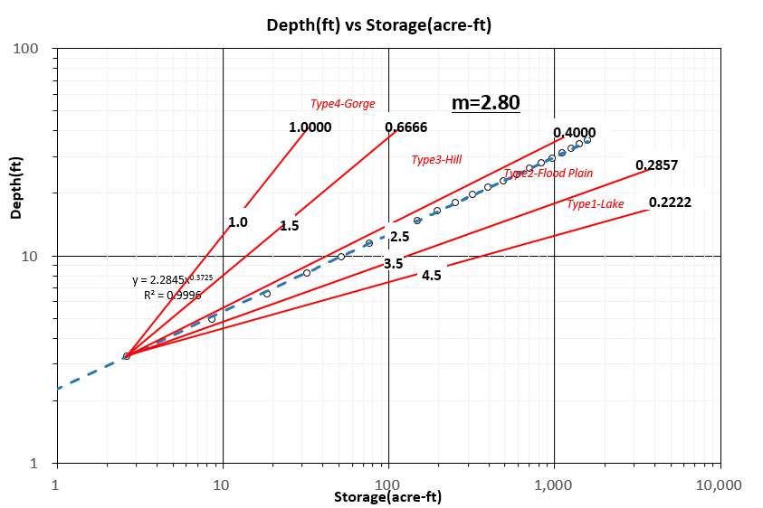
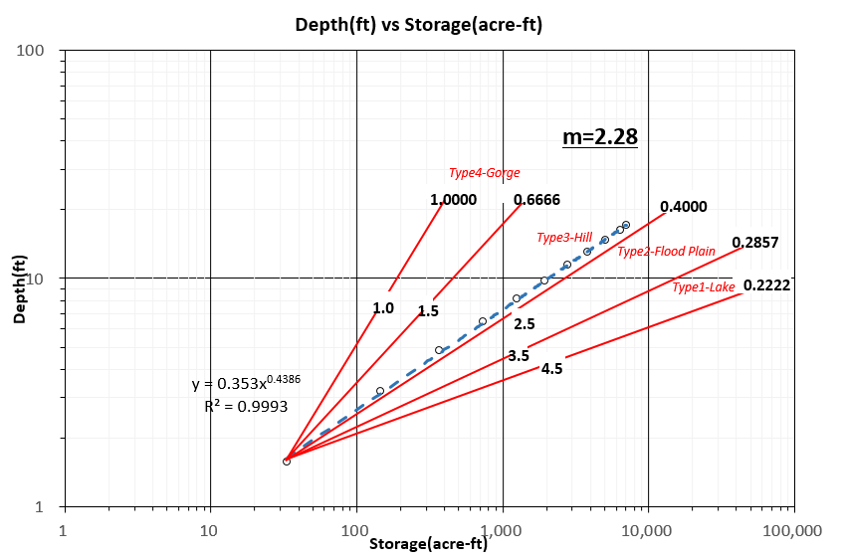
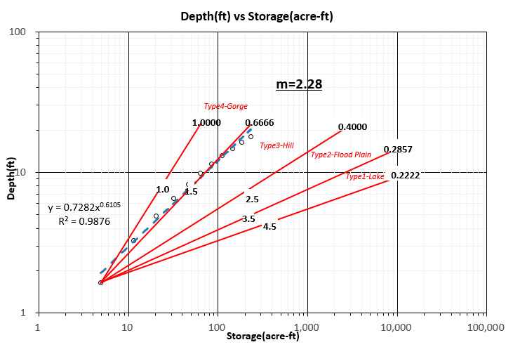
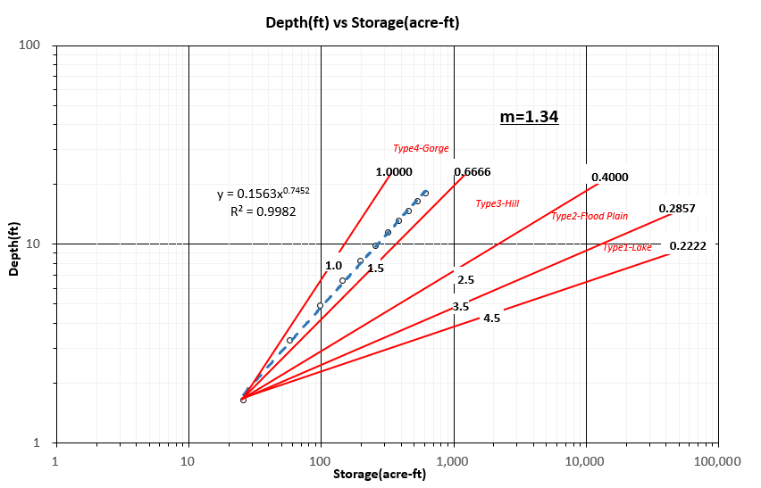
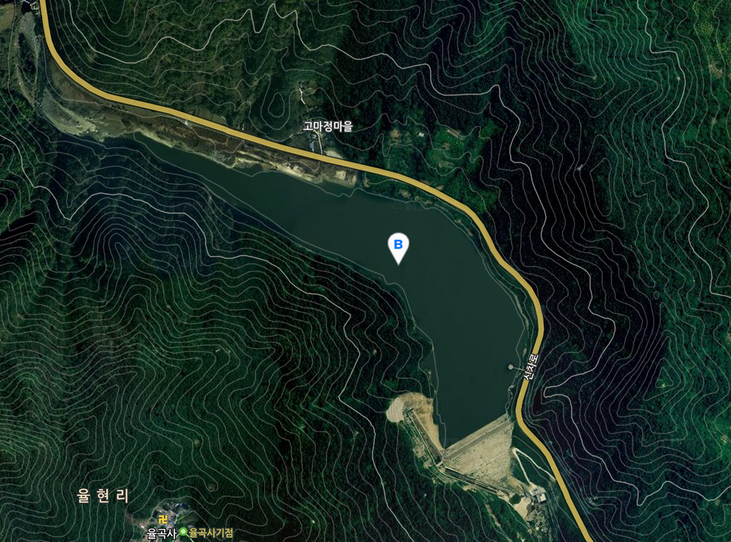
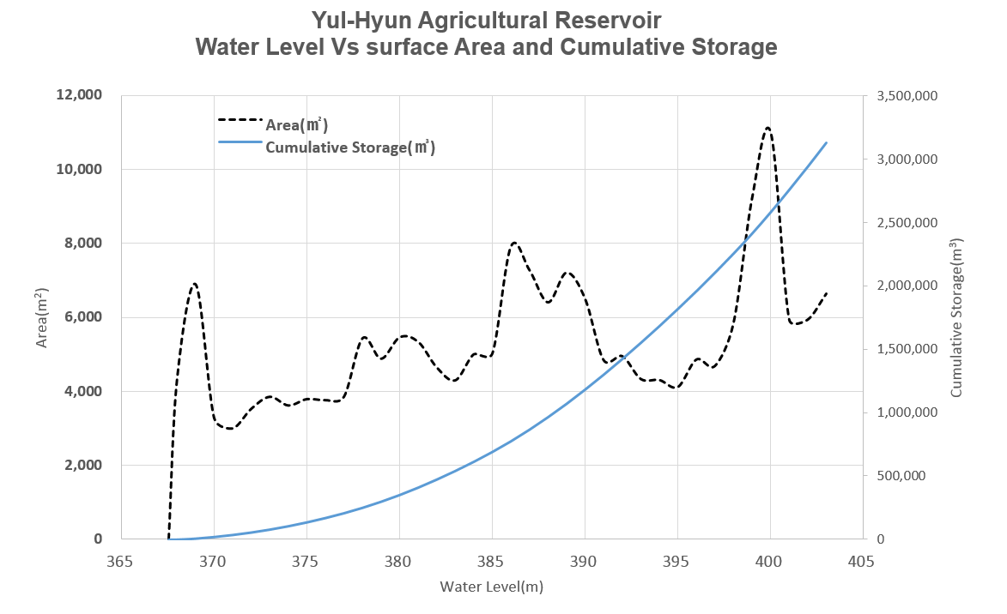
Estimation of Stage-Storage Curve of Unmeasured Reservoir in South Korea
Sung-Hack Lee, Seoul National University, Graduate Student, hacktan@snu.ac.kr
Sang-Hyun Lee, Texas A&M University, Visiting Scholar, Sanghyun@tamu.edu
Jin-Yong Choi, Seoul National University, Professor, iamchoi@snu.ac.kr
1. Introduction
This study is to analyze characteristics of stage–storage curve based on basic measures and estimate stage-storage curve of unmeasured reservoirs using satellite image and Digital Elevation Model (DEM) in South Korea. This paper use approval area, average slop of watershed, beneficial area, watershed area, effective storage, full water area, reservoir length and reservoir height as basic measures. For this Purpose, We use Geo-Morphological and statistical methods to analyze the relationship between stage-storage curve and basic measures and suggest the way of estimating stage-storage curve in the region with limited measurement
2. Literature Review
Yoo et al.(2007) analyzed a total of 18,068 agricultural reservoir in South Korea with their basic measures, and estimate average characteristics. These characteristics have also been compared with those of foreign country. This study showed the measures of dam(channel cross-section) characteristics follow the log-normal distributions and other basin characteristics follow the exponential distribution. Lee et al.(2010) estimated volume evaluation of North Korea reservoir using SPOT-5 Satellite Image. In estimating reservoir volume, this study used Geo-Morphological data(slope, area of reservoir surface) and this study suggested that estimation of reservoir volume have many uncertainty in extracting boundary of reservoir and DEM(Digital Elevation Model). Hankanson et al.(1984) analyzed the relationship between geo-morphological factors then used clustering method for grouping reservoir. Representative reservoirs were selected in each groups and extracted the storage, surface area and maximum depth. Spinter(2013) studied clustering and classifying channel morphology in eastern Oklahoma ecoregions using dissimilarity coefficients. In computing dissimilarity, Euclidian distance are used and clustered the river segments with same characteristics. In above studies, they set the similarity index and applying the clustering method. Some researchers used geo-morphological factor for extracting volume of agricultural reservoir.
3. Materials and Method
2.1 Materials
In this study, stage-storage curve of 104 reservoirs of 8 region are used for analyzing
- Average effective storage of reservoirs is 4,414,000 m³
- Average height of bank of reservoirs is 26.3 m
- Average height of bank of reservoirs is 786 ha
2.2 Method
Classification of Reservoir
Borland and Miller(1960)’s method are used for classification of reservoirs. Originally this method are used in estimating sediment in large reservoir.
Borland and miller classified reservoir in four types : Lake(Type1), Flood plain foothill(type2), Hill(Type3), Gorge(Type4)
Criteria of reservoir classification is slope of Depth versus capacity relationship in log-log graph
This slop represents geo-morphological factors around reservoir
Below graph shows the value of slopes for reservoir classification
4. Results and Discussions
4.1 Results
We classified 104 reservoirs in South Korea by Borland and Miller(1960) Method
Most of reservoirs in this study are artificial resevoirs , So Lake and floodplain foothiil is not appeared
Most of reservoirs placed in Hill and Gorges. Actually many reservoirs constructed in mountainous area in South Korea.
There are need more detail classification between hill and gorge in South Korea
Below results show the four types of results in classification of reservoirs in South Korea
4.2 Discussions
There are geo-morphological differences between South Korea and U.S.
Most of reservoirs are constructed in mountainous area in South Korea. So, Gore and Hill are classified more detail.
In this study, we use 104 case reservoirs for analysis, we need more cases for general use.
When we using satellite image for estimating capacity and available water in reservoir which is not measured or cannot access, we need other factors for reservoir classification
Connecting factors must be geo-morphological factor that can collect from satellite images
This study will helpful to analysing status of water resources in North Korea using satellite images
Fig 4.Classification of reservoirs by depth-capacity relationship Borland and Miller(1960)
Fig 1. Process of Stage-Storage Curve Estimation from Lee(2010)
Satellite Images of Reservoir
Virtual Contour
TIN Generation and Storage Calculation
Fig 5. Floodplain foothill type – Daejung reservoir
Fig 6. Hill type – Hungduk reservoir
Table 1. Specification of reservoirs
Fig 7. Gorge-Hill type – Sansu reservoir
Fig 8. Gorge type – Okgae reservoir
Region | No. | Average Effective Storage(10³m³) | Average Height of Bank(m) | Average Irrigation Area(ha)
KyungKi | 5 | 2,064 | 24.5 | 919
KangWon | 5 | 1,389 | 23.8 | 772
KyungNam | 10 | 2,089 | 37.4 | 741
KyungKuk | 22 | 1,890 | 22.8 | 732
JunNam | 20 | 15,981 | 23.5 | 783
JunBuk | 15 | 2,745 | 34.8 | 782
ChungNam | 15 | 4,811 | 20.0 | 778
ChungBuk | 10 | 4,345 | 23.3 | 782
Fig 2. Arial view fo Yul-Hyun reservoir
Fig 3. Water level vs area and cumulative storage curve

