Slide 1
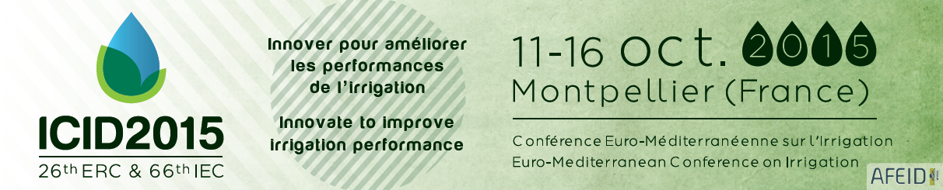
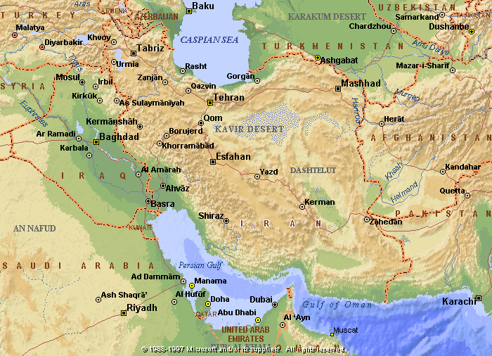
A method to map flooding-prone areas in Iran using Landsat satellite images and GIS
Ali Bozorgi, Iran Water Resources Management Company, bozorgi.ali@gmail.com
Kowsar Assari Arani, kowsar.assari@gmail.com
Hamid Salehi Shahrabi, Iran Water Resources Management Company, hamidsalehi2007@gmail.com
Abstract
the aim of this study was to make a method to map flooding-prone areas along with introducing a novel method for rating them. With the aid of this method, new areas would be identified using geological and topographic maps and the data can be used for decision making and prioritization by Multi-spectral satellite imagery.
The first step in the development and operation of new flooding projects considering artificial recharge is the identification of susceptible and prone areas. It is evident that in the Quaternary deposits, alluvial fan which is consisted of upper basin and coarse alluvium has a special potential for Flooding. It is worthwhile to remind that in order to identify the alluvial fan in the Quaternary deposits, geological, topographic, slope and aspect maps should be used.
Multi-spectral satellite images not only share spatial data and alluvial fan areas, but also provide a broad descriptive information. This kind of information can be used for classifying in terms of alluvial fan priority for flooding. Therefore, considering this attitude, alluvial fans are considered as the unit of studying for Flooding and aquifer management. In order to choose the type of false color images, various combinations of multi-spectral satellite images were created according to minimum correlation between bands. However, based on the objectives of this project, the band combination of 1, 4, 7, or RGB 741, was found suitable for interpretation. This combination of false color has some benefits. For instance, the vegetation and water colors in the image appear the same as their original color. Moreover, soil and rock specifications would be more apparent due to the existence of the 7 band in the color combinations. Besides, in the visual interpretation of images, the interpreter is able to map easily the boundary of alluvial fans according to the pattern and shape of them. In other words, the Interpreter can consider the agricultural lands and urban areas while separating the units on the satellite images. Thus, the upstream of those quaternary sediments with potential water resources and no agricultural activities would be identified.
In essence, the aim of this study was to investigate 21 parameters for identifying the flooding-prone areas in the alluvial fans of Iran. As a result, 2450 points of studied areas (with a 9640000 ha area) were found susceptible to flooding.
Keywords— Flood mapping, Flood management, Satellite images, GIS.
Introduction
Methodology
Using satellite images and geographic information systems as a cheap source for determining flooding prone areas and mapping them in the shortest time is the purpose of this study. We have described the steps and a summary of research methodology in the following
Case study
Iran country as The Studied area that covers over 1,648,195 Km2 is located in Middle East. Iran is located 44° to 64 ° east longitudes and 25 ° to 40 ° north latitude. Iran region is one of dry parts of World with water scarcity for agricultural purposes which is showed in fig1.
Results and discussion
Considering the extensive range of study and work scale (1:250000), It is evident that identifying appropriate locations for water prone flooding areas and aquifer management would take a considerable time. If we have used other methods, we could not investigate the results in a short time.
Therefore, it seems that the used method which is based on visual interpretation of satellite imagery and deployment of digital data in GIS is considered as a fast and reliable method. In addition to the quickly procedure for mapping the flooding prone areas, some investigation also are done on the successful projects. They indicate that the mentioned method is reliable. In this initial stage, all talents for flooding and aquifer management are identified and they are mapped. We also have prepared the characteristics of alluvial fan which contains about ten parameters for each of them through interpretation of satellite images. Flood Area locations along the upstream catchment area and runoff coefficient was transferred to the database In order to estimate the amount of flood in each unit. Total area of each vegetation and land use sites (especially agriculture) which are obtained in the interpretation of satellite images also were identified. In essence, the aim of this study was to investigate 21 parameters for identifying the flooding-prone areas in the alluvial fans of Iran. As a result, 1450 points of studied areas (with a 9640000 ha area) were found susceptible to flooding. That is shown in fig.2
Prioritization criteria for determining Flooding prone areas and the aquifer management
With the terms of existing data in the database, the parameters in the decision phase are prioritized into the main and tributary.
The main parameters in determining the appropriate Flooding prone areas
These parameters include:
A: There are alluvial fan or alluvial deposits and deposits coarse
B: slope and limitations of it
C: The distance from the villages or village boundary
Conclusion
The satellite images were georefrenced and their bands were combined together in order to identify the flooding areas and also preparing the slope layers, distance from population centers , agricultural lands, distance from rivers and water resources layer based on the mentioned methods. We have found that almost 9640000 ha of the Quaternary deposits of the studied area (165000000ha) that is around 7.6% had the potential for flooding. By overlaying the prepared layers, we have identified the flooding prone areas; consequently about 4.7 % of the whole studied area addition to potential applicability is having the capability for operating flooding systems.
The information provided on the maps has accuracy according to 1:100000 and 1:50000 scale.
By operating these projects it would be possible to supply large amounts of water in the region. It is also presented the map positions with priority of projects implementation.
References
Abdi parviz, Investigation of the geological characteristics of Quaternary deposits in order to determine the potential for artificial recharge of groundwater in Zanjan Plain,1999
Ghaioomian parviz, Prioritizing the quaternary deposits for flooding, Soil Conservation and Watershed Management Research Institute, 2002
Sabinz JR. Floyd F., remote sensing, Second edition, New York, 1987
Soil Conservation and Watershed Management Research Institute, finding suitable locations for flooding,1380
Stan Aronoff, Geographic Information Systems: A Management Perspective,1993.
Figure2- the identified prone areas for flooding
Figure1- the project map

