Slide 1
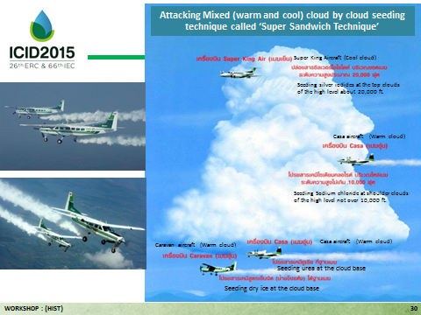
History of Water Crisis in Thailand and Its Preparation for the 2015 Drought.
PRECHAWIT Chaiwat, THAICID, c_prechawit@hotmail.com
History of water crisis in Thailand.
Thailand is a country that frequently encounters water crisis, especially floods and droughts. The most damaged natural disaster to the country’s economy was the extreme flood of 2011. After that year all the planning and development were geared towards flood protection. However, just a few years afterward drought occurred for a few years in a row. The 2015 drought that Thailand is facing now may create a real problem to the agricultural sector.
More than half a year of 2015 already passed and enters the rainy season, but Thailand is now facing one of the most serious droughts in recent years. There were only meager rains that were not enough for the crops and also did not produce runoffs for inflows of the reservoirs. The water stored in reservoirs depleted to the lowest levels. Bhumibhol and Sirikit reservoirs, which are the most important water sources for the central plain of Thailand where the important economic areas including Bangkok, the capital, are situated, are at the second lowest level and can be used for only 40 days if there are no additional inflows to the reservoirs.
The Thai government has been working hard to mitigate the effects of the drought on the people and especially on the farmers. Postponement of the commencing of the rainy season rice crop was announced. The government provided budget for making shallow wells to help 3.4 million rai (600,000 ha) of areas already planted.
Style “ICID 2015 Title level 1” (Arial, 38pt, bold)
In 2015 water level in Bhumibhol reservoir is at it’s lowest.
Because of very low water in the reservoirs and no runoff from sideflows to be available, the delivery of irrigation through the large system of irrigation canals were interrupted causing low water levels in the canals for a long period of time. This caused another serious problem to the service roads (which have already been transferred to be public roads) along the irrigation canals. With very low water table the embankments had no support and became unstable and finally slided and failed on many long stretches. This problem occurred in many places in the lower Chao Phraya Delta, where the soil is thick soft clay soil called Bangkok Clay.
The Government and the Royal Irrigation Department have issued many mitigation measures to prevent more serious consequences:
- Adjustment of wet season rice cropping schedule to match availability of water.
- Delay planting of rice in some areas.
- Not allow second crop of rice in the dry season.
- Minimum releases from reservoirs to save water as much as possible.
- Digging of shallow wells to supplement supply of surface water.
- Pumping or diverting from nearby river basins.
- Artificial rain making.
Using of weather modification by artificial rainmaking to help farmers in drought-stricken area.
The Royal Rain Making was pioneered by His Majesty King Bhumibhol Adulyadej of Thailand.
In 2015 it was operated in 11 provinces.
More than 642 flights operation (1,042 hrs) till beginning of rainy season.
Estimate increase in inflow into reservoirs 1,024 mcm.
United States Patent Application Publication.
United States Patent Application Pub. No. 2005/0056705 A1, Pub. Date: Mar. 17, 2005.
WEATHER MODIFICATION BY ROYAL RAINMAKING TECHNOLOGY
Inventor: His Majesty King Bhumibhol Adulyadej, Bangkok (TH)
Appl. No. 10,662,145
Filed: Sep. 15, 2003
The Royal Rainmaking Process.
photo, graph, table, chart…
Rainfall in 2015 compared with normal rainfall in 1981-2010.
Rainmaking planes in action.

