Slide 1


Note to authors
Dear Author,
We would be very pleased to welcome you in Montpellier for this side event.
We firmly believe we need to learn from experience to build a framework that can be adapted to different types of water reuse (different sources of water and biosolids)
We have three hours to share our experience, discuss, and select promising ideas.
We believe the key to success is sharing the widest possible range of experience, which can only be achieved if everyone is brief.
You have between 5 and 10 minutes to answer one (or both) of the following questions based on your experience:
Which are the best practices, technologies, methodologies and institutional framework to create effective, safe and cost effective water reuse chains?
and/or
Can we successfully reuse raw or low treated waste water?
Would you like to take part? If so, please follow these instructions:
Read the note on the presentation of the side event (EN)
Please use the template, don’t write out the whole presentation, but give concrete examples. (Slide 4 is an example)
Submit your presentation via the platform or email it to caroline.coulon@irstea.fr
We will acknowledge receipt of your contribution
Thanks in advance for your collaboration, and we look forward to seeing you soon.
Nicolas Condom (PhD), vice chairman (nicolas.condom@ecofilae.fr, Samia El Gendy (PhD),, vice chairman (samia.guindi@gmail.com

Slide 2
Name of the speaker
Organisation, email
CASE STUDY NAME
short description
Map to localise the project
Logos, Partner

Slide 3
Description of the case study
Poject’s name | Country | City | Start Date-End Date | Water Sources | Uses
______ | _______ | ________ | _______ | ______ | ______
Figures (PID, scheme)
Sources
Origin | Industrial, domestic, urban
Water reused (m³/Y) | _____
Uses
Crops | maize, beetroot, wheat, vegetables
Irrigated Area (Ha) | ______
Cost of the Cubic meter (€/m³) | _______
Pictures
Water Reuse Chain
Treatment | Step 1, step 2Lagoon, activated sludge, biofilter, MBR
Disinfection | UV, Chlorination, Ozone
Storage Capacity (m³) | Tank (XXX), Lagoon (XXX)
Irrigation | Sprinkler, Surface Irrigation

Slide 4
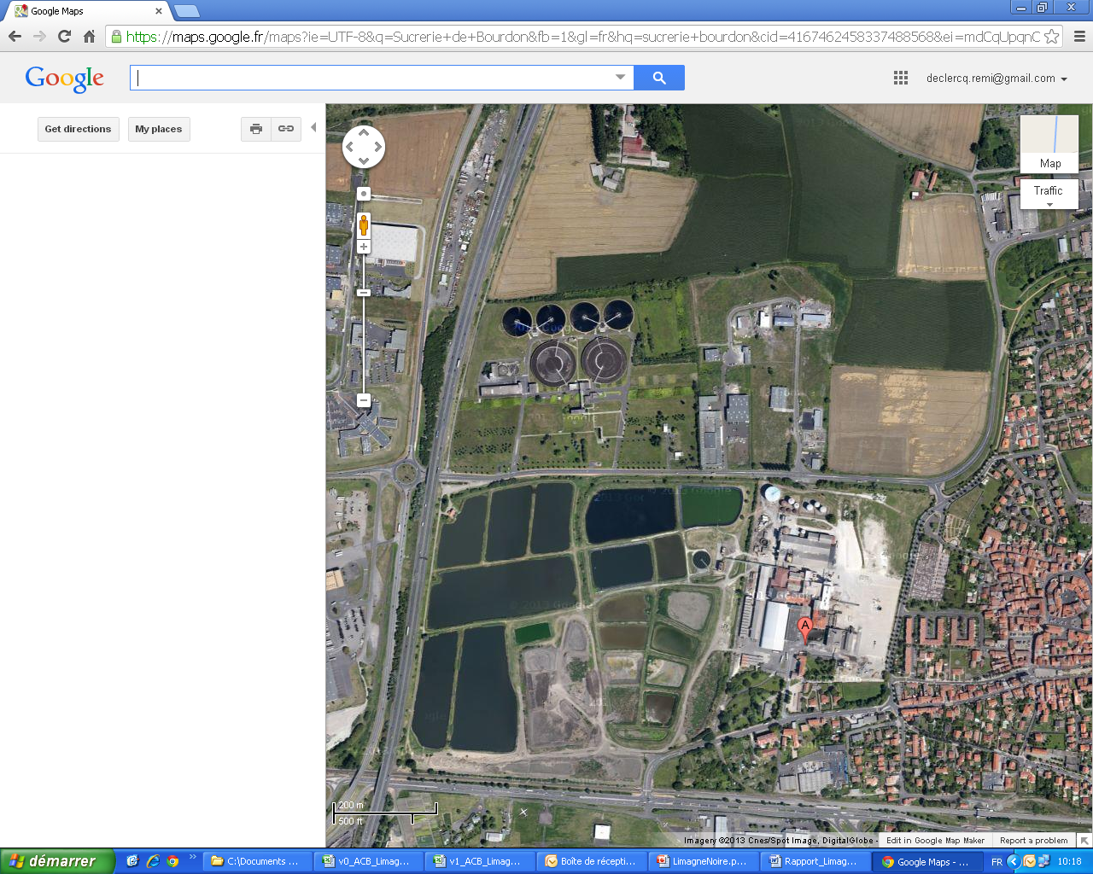
EXAMPLE-Description of the case study
Poject’s name | Country | City | Start Date-End Date | Water Sources | Uses
ASA Limagne Noire | France | Clermont-Ferrand | 1996 - | Domestic Wastewater | Agriculture
Sources
Origin | Domestic Wastewater
Water reused (m³/Y) | 900 000
Uses
Crops | Corn, Rice, Grasslands, Wheat, aquaculture
Irrigated Area (Ha) | 1400
Cost of the Cubic meter (€/m³) | 0 €
Water Reuse Chain
Treatment | Lagoon, activated sludge
Disinfection | No
Irrigation | Sprinkler
Storage Capacity (m³) | Lagoon (200 000)

Slide 5
How do I illustrate the question:
Which practices, technologies and institutional framework to create effective, safe and cost effective water reuse chain?

Slide 6
How do I illustrate the question:
Can we successfully reuse raw or low treated waste water?

