Slide 1
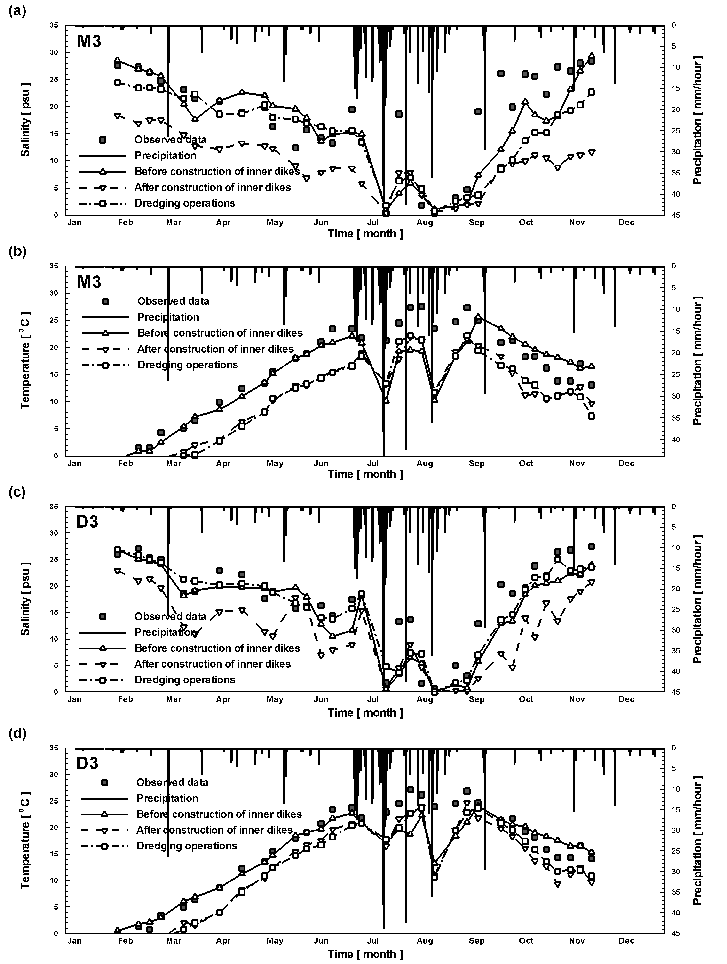
Numerical Simulation on Hydrodynamic Characterization Changes Associated with the Stages of Internal Development Construction in Saemangeum Reclaimed Area
ChanSung Oh, Korea Rural Community Corporation, yes_csoh@erk.or.kr
JungHoon Choi, Korea Rural Community Corporation, cjh5181@erk.or.kr
JinYong Choi, Kunsan National University, jinyong@kunsan.ac.kr
JaePil Cho, APEC Climate Center, jpcho89@gmail.com
INTRODUCTION
EFDC(Hamrick, 1992)
Hydrodynamic numerical model
It can simulate environmetal assessment and management in water bodies such as lakes, rivers, reservoirs and estuaries.
A sigma-stretched vertical coordinates and Cartesian or curvilinear-orthogonal horizontal coordinates
In this study, the linearized matrix equations are solved by conjugate gradient method and momentum equation is solved by explicit solution.
A Saemangeum Development Project is a national project and has started with the objective of developing the reclaimed area for mainly agricultural land since the mid-80s. To develop a model of the global eco-reclamation, construction of eco-friendly the counter facilities such as sluice gates and internal developing structures, as well as environmental preservation measures for estuary reservoir, has been carried out. The Comprehensive plan in January 2010 and The Master Plan in March 2011 on Saemangeum development have formulated and released, and seawater circulation condition through the sluice gates has been proposed for water quality management to prevent deterioration of water quality due to internal development construction. a number of numerical models have been developed and applied dealing with the mixing characteristics of freshwater and seawater, the methods of water quality management in rivers, reservoirs and estuaries. The purposes of current study are to effectively simulate and quantitatively analyze a fully coupled density-dependent salinity and water temperature transports during the stage of internal development construction in Saemangeum reservoir considered seawater circulation condition. To achieve these objectives, A series of transient-state numerical simulation with model calibrations is then performed to demonstrate the density-dependent hydrodynamics modeling using a generalized multidimensional hydrodynamic numerical model.
NUMERICAL MODEL
NUMERICAL SIMULATION SETUPS 2
Initial and boundary conditions
The initial conditions for numerical modeling are composed of managed water level, water temperature, salinity and meteorological data.
Initial managed water level by scenario simulations are assigned to EL. -1.6 m by SN1 and EL. -1.5 m by SN2 and SN3, respectively.
The observed water temperature and salinity data at Saemangeum reservoir in 2011 are used as initial input conditions.
The landward boundary conditions are assigned to water inflow amounts and water temperature, while seaward boundary conditions are assigned to water level according to operations of Gareok and Sinsi sluice gates, and salinity and water temperature.
STUDY AREA
Numerical modeling calibration
The model verification parameters are %difference, RMSE and AME.
The observed water temperature and salinity data are repeatedly compared with the simulation ones until %difference reaches the ‘Fair’ standard.
Description of the study area
The study area is located on the western coast in the whole area of Buan, Gimje and Gunsan, Republic of Korea.
The sea dike, enclosing the Saemangeum estuary, reaches to 33 km long and comprise of four dikes.
The Gareok sluice gate with 8 gates completed in December 2003, while Sinsi sluce gate with 10 gates completed in December 2006, and they are now operational for managing of water level in the Saemangeum reservoir.
The managed water level of the reservoir temporarily maintain EL. -1.5 m and the storage capacity is 535.4 million m³, available storage is 354.7 million m³, and water surface area is 96.7 km².
The Saemangeum watersheds comprises two major river basins.
The hydrodynamic characteristics of study area may be dependent on freshwater inflow amounts from Mankyeong and Dongjin watersheds to the Saemangeu reservoir and the amounts of seawater circulation according to the sluice gate operation.
Fig. 1. Status of Saemangeum reservoir.
Monitoring point | Validation parameter
 | %difference |  | RMSE (⁰C / ppt) |  | AME (⁰C / ppt)
 | Temperature | Salinity | Temperature | Salinity | Temperature | Salinity
M1 | 2.53 | 26.73 | 1.61 | 0.12 | 0.43 | 0.09
M2 | 23.28 | 38.63 | 5.85 | 9.04 | 4.81 | 4.34
M3 | 26.81 | 4.68 | 7.30 | 8.50 | 5.49 | 0.78
M4 | 17.92 | 9.22 | 3.84 | 3.30 | 3.32 | 2.09
D1 | 5.98 | 19.71 | 1.89 | 0.04 | 1.00 | 0.03
D2 | 17.76 | 14.95 | 4.35 | 8.64 | 3.38 | 2.20
D3 | 23.39 | 14.42 | 6.03 | 6.35 | 4.69 | 2.51
D4 | 9.82 | 4.27 | 2.11 | 2.91 | 1.66 | 1.02
Fig. 2. Locations of external inflows and pumping wells.
NUMERICAL SIMULATION RESULTS
Geum-river estuary
Yongdam dam
A maximum salinity of 21 psu is shown in the spring season and seawater would be temporarily replaced fresh water in the summer season. The salinity at D2 and D3, M2 and M3 are getting reduced by about 2∼5 psu after constructions.
This is because the managed water level gets higher up to EL. (–) 1.60 m → EL. (-) 1.50 m and the influence of fresh water gets extended as the irregular flow of water body before construction forms consistent and fast fluid velocity along the well-regulated waterway after the constructions.
The water volume after dredging operations gets greatly increased compared to before dredging and these changes are determined as being caused by smooth inflow of seawater to the upper stream with the increased residence time of seawater in lower layer. Especially, the salinity is increasing by as much as about 10 psu after dredging at M2, M3, D2, and D3.
Fig. 4. The temporal changes of salinity and temperature according to internal development construction at M3 and D3.
Pumping well
Seumjinriver dam
(Unit : 10⁶ m³/yr)
NUMERICAL SIMULATION SETUPS 1
Fig. 3. Grid structure and locations of monitoring points .
Grid configurations
The computional grids are constructed based on the stages of internal development construction, which are divided into 3 scenarios to predict the changes of the water quality in Saemangeum reservoir.
Parameter | Value
Scenario | Before construction of inner dikes (SN1) | After construction of inner dikes (SN2) with dredging operations (SN3)
No. of horizontal cell | 8,260 | 5,643
No. of vertical cell | 5
A period of numerical simulations and time step sizes | 365 days / 5 sec
Grid sizes | △ x = 39.5~738.9, △ y = 37.8~605.5
Therefore, it may be concluded that hydrodynamic characteristics on Saemangeum are dominated by either Mankyeong or Dongjin discharge or seawater circulation amounts from sluice gates as well as topographic characteristics, and thus they must be properly considered.
SN1 Grid
Acknowledgements
SN2 and SN3 GridS
This work was supported by the Korea Rural Community Corporation, Republic of Korea

