Slide 1
Socio-economic interests of treated wastewater reuse in agriculture
Clermont-Ferrand case study cost-benefits analysis
Rémi Declercq (Ecofilae) and Sébastien Loubier (IRSTEA)

Slide 2
Which wastewater reuse scenario?
SUSTAINABLE SCENARIOS?
THE MOST PROFITABLE SCENARIO?
Sustainability of
a wastewater reuse project
=
Security
x
Profitability
x
Feasibility
x
Acceptability
x
Organisation
sanitary
agronomical
environmental
economic
financial viability
technical
(process)
regulatory
social political
legal framework institutional
Source : Ecofilae, 2015
Notes:
Facing wastewater reuse decision makers have to choose between several scenarios (ex Cannes) → Which one are sustainable? To be sustainable they have to be profitable.
CBA have been implemented but they often only consider direct cost and benefits (investments, charges, direct benefits) but they scarcly integrate indirect costs and benefits (socio environmental externalities)

Slide 3
Cost-Benefit analysis methodology
Used for analyzing project to determine whether or not they are of public interest (economic profitability)
To identify which stakeholders lose/win and the actions to implement to reach win/win solutions
Sphere analysis characterization (time line, geography, stakeholders involved)
Identification of the different projects scenarios (reuse scenario(s) and business-as-usual scenario)
Costs and benefits identification and assessment for the different scenarios
Net present value (NPV) calculations
Sensitivity analysis of NPV to the main parameters
Notes:
One widely used tool used to assess economic profitability is the CBA

Slide 4
Net Present Value
the relevant economic indicator
NPV = Net Present Value
B = Benefits
C = Costs
T = time horizon set
r = discount rate
 |  | Private NPV
Community public NPV |  | Project feasible without intervention | Project to subsidize
 |  | Project to be dissuaded | Project not feasible
Notes:
From the community point of view the only relevant economic indicator is the NPV
Once they have been estimated costs and benefits need to be assessed in present value before being added/summed. To integrate the preference for the present into the analysis the discounting principle is used
Beware: costs ansdd denefits similar in the 2 scenarios are not considered
NPV is equal to the sm of discounted benefits minus the sum of costs
Et d’autres paramètres que NPV?
Pourquoi on ne les a pas regardés?

Slide 5
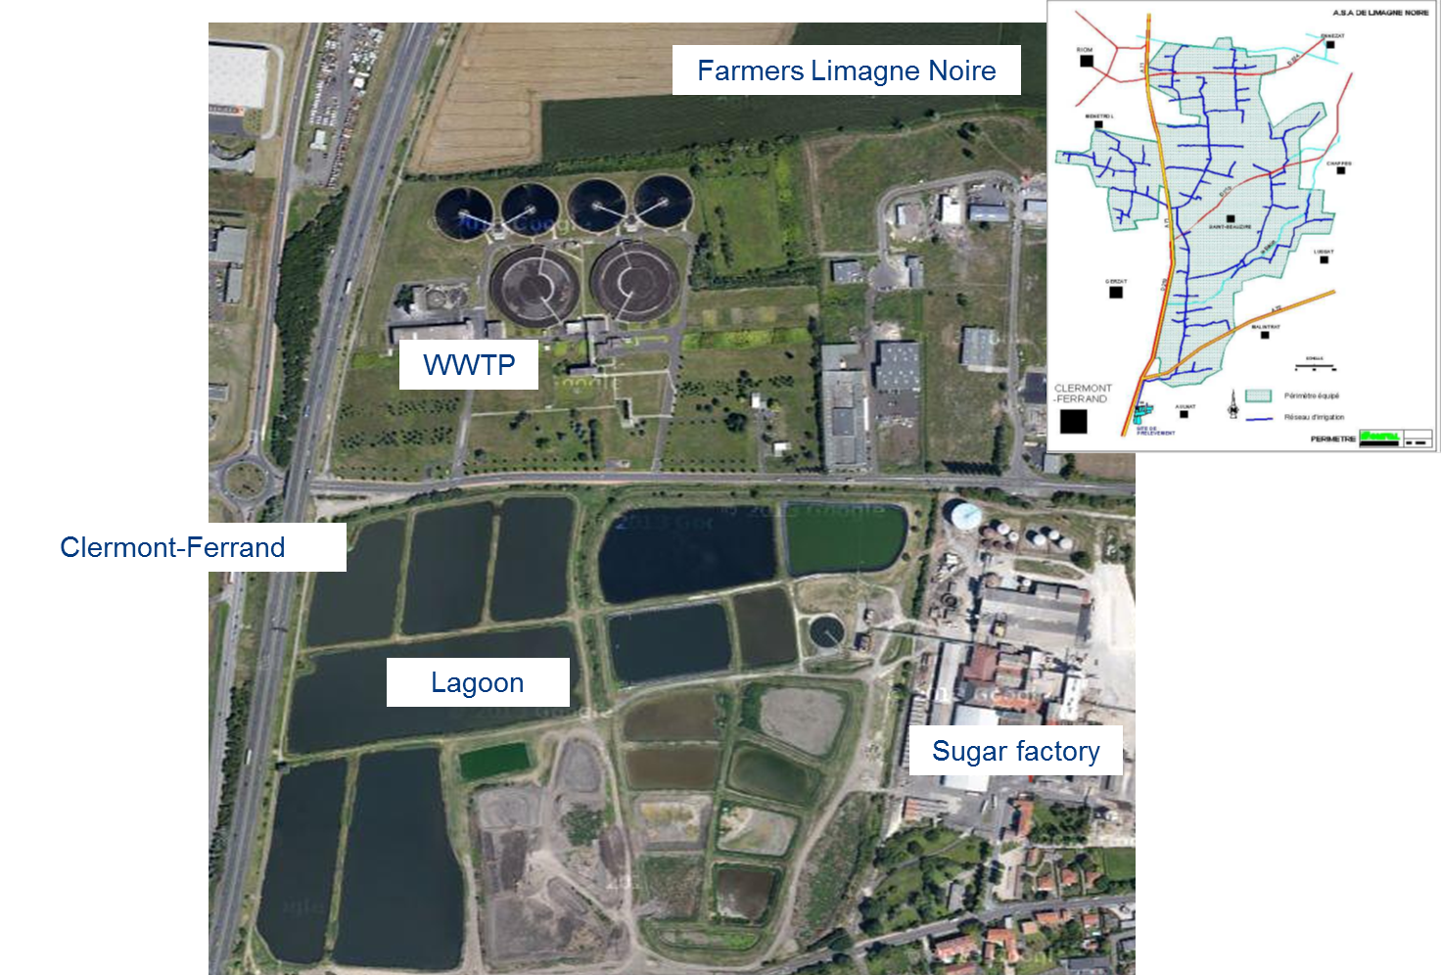
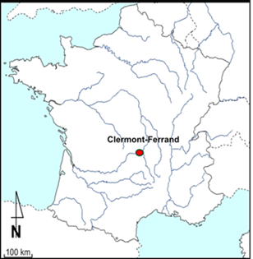
Clermont-Ferrand case study
Notes:
Just say (describe the reuse scenario in the following slide):
Water scarcity in the area
Proximity WWTP, fertile crops land and a sugar factory with 12Ha of lagoons
For the ACB lets compare two scenarios : existing implemented reuse scenario and the contrefactual business as usual scenario
Time ehorizon is set to 50 years
Discount rate at 2,5%
Ex post analysis

Slide 6
Treated wastewater reuse scenario

Slide 7
Contrefactual business-as-usual scenario

Slide 8
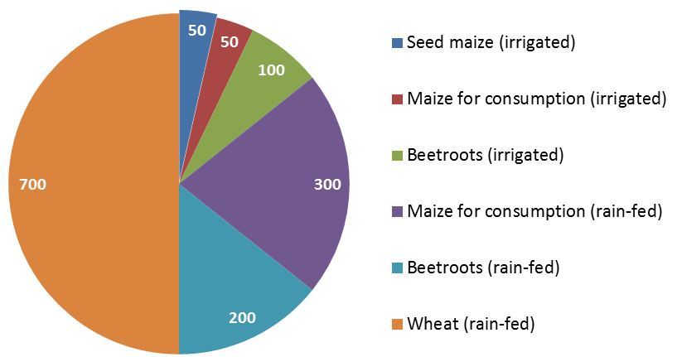
Scenario comparison
Crops distribution
Reuse scenario
Contrefactual scenario
73.3 M€
60,6 M€
Agricultural gross margin

Slide 9
Main cost and benefit considered
Investments (irrigation material, lagoons rahabilitation, distribution system, sanitary studies)
Annual charges (operational, maintenance, energy)
Agricultural gross margin
Avoided cost of treatment for the sugar factory effluents
Subsidies from funding agencies
Notes:
We did not consider
environmental benefit (cause no pertinent here)
the decrease of risk for irrigant farmers & induced effect on the upstream and downstream sectors in termes of employement and added value

Slide 10
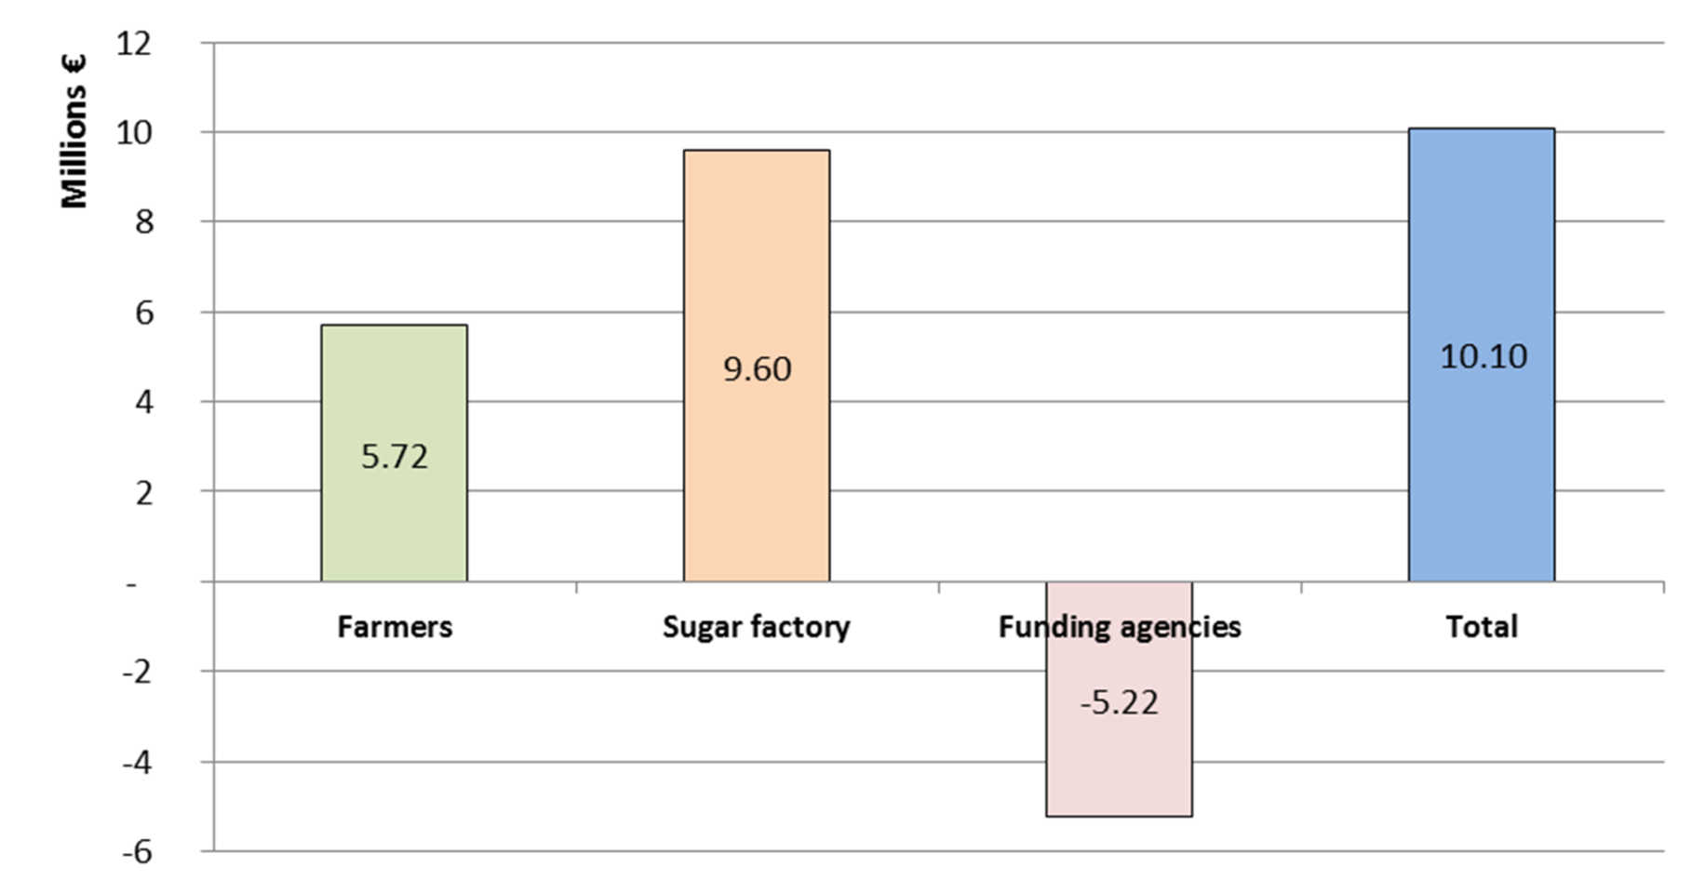
Net Present Value
NPV
Notes:
Et d’autres paramètres que NPV?
Pourquoi on ne les a pas regardés?

Slide 11
Sensitivity analysis
Monte-Carlo method to deal with uncertainity
Hypothesis
Uncertainties
PARAMETERS | Deterministic approach | Lower and upper limit
Energy price increase rate | 0%/year (0,05€/m³) | [0% ; +5%]
Sugar factory effluents treatment costs | 1,9 €/m³ | [-20% ; +30%]
Irrigation equipment life-time | 20 and 50 years | [-30% : +30%]
Crops water needs | 1 200 to 1 400 m³/Ha | [-10% ; +20%]
Agricultural production price variation | 180 to 270 €/T | [-30% ; +30%]
Seed maize area variation | 434 Ha (reuse) | [-30% ; +10%]
10 000 random draws
NPV dispersion
Notes:
Pourquoi monte-Carlo et pas une autre? Qu’est ce qu’on aurait pu faire sinon
Comment on a choisi ces 6 paramètres et pas d’autres?

Slide 12
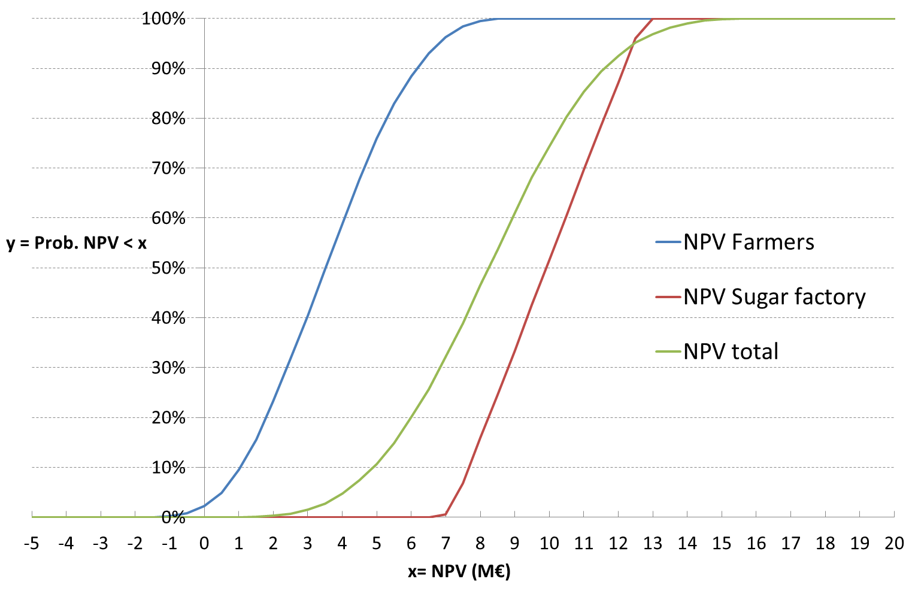
Sensitivity analysis
NPV dispersion
Notes:
Uncertainities affect more the farmers NPV than the sugar factory

Slide 13
To go further…
CBA = An economic support tool for decision-makers
In Clermont-Ferrand TWWR is profitable but collective incentives could be implemented to allocate equally the collective net benefit
Investment subsidies could have been lower
Need to consider different time horizons and present time preference from the collectivity and the private point of view
Difficulties to account for the possibility that agricultural land would be used for another activity in the business-as-usual scenario
Need for further methodological developments → TWWR tailored environmental and social indicators
Need for more feedbacks / lessons from experiences

Slide 14
Thank you for your attention

