Slide 1
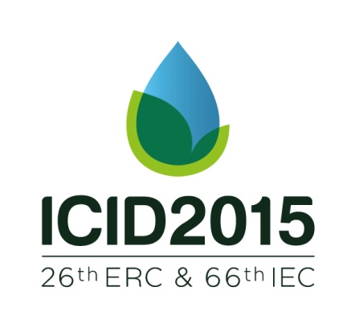
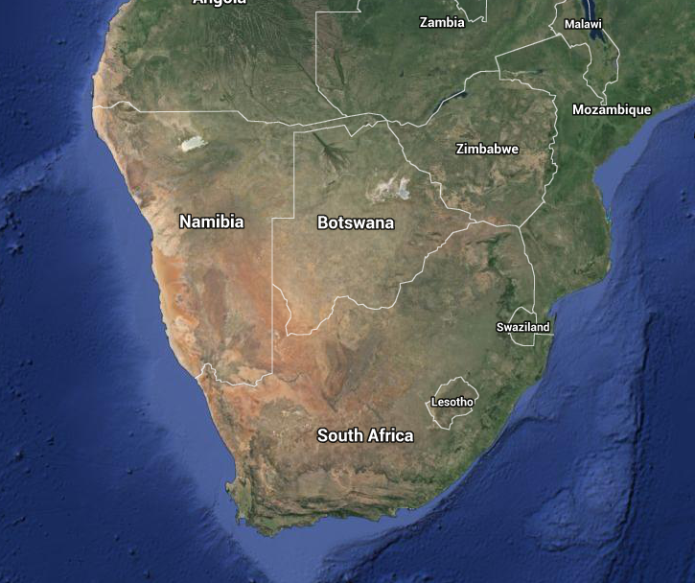
Michael van der Laan michael.vanderlaan@up.ac.za
Irrigation as part of an Acid mine drainage treatment strategy
Decanting acid mine drainage is presenting a major problem in the economic heartland of South Africa / Reverse osmosis (RO) proposed as solution but very expensive and energy intensive / Irrigation represents an attractive alternative to RO as it removes significant salt loads and can use the water productively to produce crops in a food insecure region
Vaal Basin

Slide 2
MANAGING POOR QUALITY MINE WATER: IS IRRIGATION PART OF THE SOLUTION?
Quality of water decanting from mine voids in South Africa varies, but often acidic and saline, dominated by CaSO₄, Na₂SO₄, MgSO₄ or NaHCO₃
Results in a salinity problem as there is not enough clean water available to dilute the salts and still achieve water quality objectives
Technology principle:
Irrigation with CaSO₄ rich mine water

Roots take up water and concentrate the salt –
precipitation of gypsum in the soil profile

Salts therefore removed from the water

Slide 3
MANAGING POOR QUALITY MINE WATER: IS IRRIGATION PART OF THE SOLUTION?
Irrigation with neutralised acid mine drainage
69% salts removed from water

