Slide 1
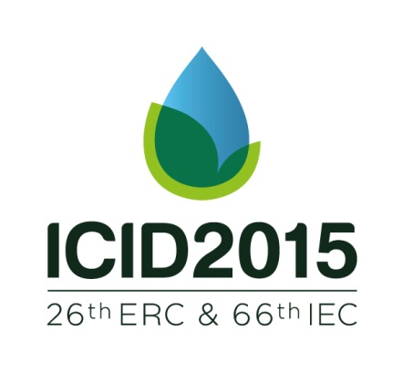
Zapata, N. (*), Castillo, R. and Playán, E.
COLLECTIVE IRRIGATION NETWORK DESIGN AND MANAGEMENT FOR ENERGY OPTIMIZATION: THE “CINTEGRAL” TOOL
Estación Experimental
Aula-Dei

Slide 2
Presentation outlines
1. Introduction
2. Material and Methods
3. Result and Discussion
4. Conclusions

Slide 3
Introduction
Farmers were concerned that the important increase of conventional energy resources prices were reducing dangerously their profit margin.
Although the costs of fossil‐fuel/derived energy and electricity fluctuates, an upwards trend is expected (EIA, 2015).
To be efficient in the use of irrigation water (applying irrigation when needed and in the amount that the crops need) is not sufficient when water is applied through pressurized irrigation systems.

Slide 4
Introduction
It is necessary to be efficient with the use of energy and reduce it cost.
Scheduling irrigation when crop requires and when the energy cost is low (Time-Based Electricity Rates).
To adopt renewable energy resources (wind or solar).
Reducing the energy used per unit of irrigation water applied.
Improving the efficiency of the collective and on-farm network infrastructures (pumping station, hydraulic network functioning…)
Reducing the required pressure at the emitter (impact sprinkler, deflecting plate sprinklers)

Slide 5
Introduction
Traditional solid-set irrigation designs have often aimed at ensuring a minimum of 300 kPa at the nozzle of the impact sprinklers.
Encouraging results were provided by Playán et al. (2006) for the same type of impact sprinklers when reducing the pressure at the nozzle from 300 kPa to 200 kPa.
Furthermore, recently, new impact sprinklers have been commercialized which have been specially designed to operate at reduced pressures (200 kPa). These new sprinklers are based on developments by Kincaid (1991).
The general objective of this work was to analyze the effect of changing the pressure at the nozzle of the sprinkler from 300 kPa to 200 kPa on crop yield and net productivity. The study was performed for a collective irrigation network with the simulation tool CINTEGRAL.

Slide 6
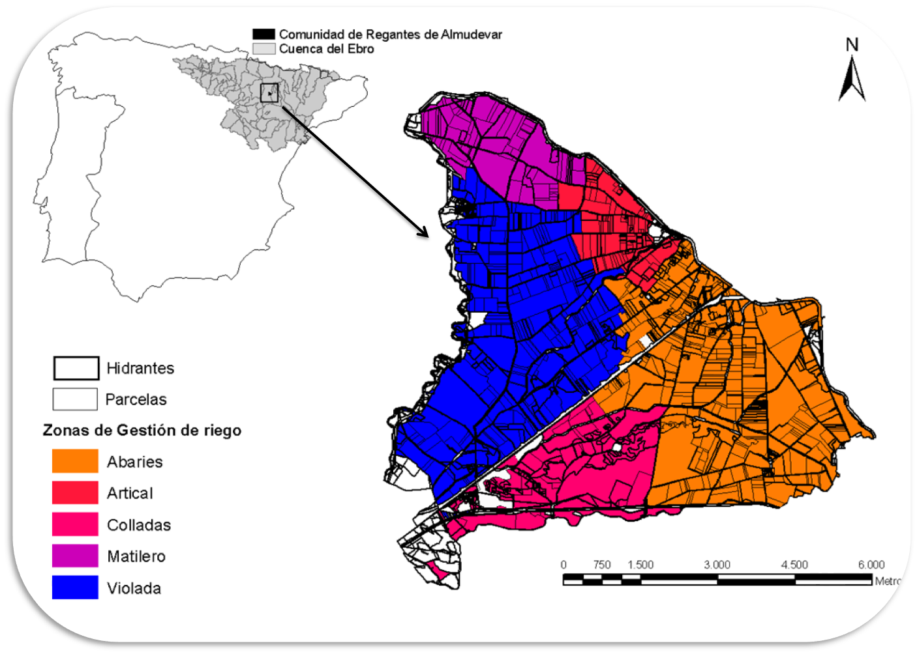
Material and Methods
The study area:
Collective irrigation networks
Notes:
The Violada is one of the five pressurized irrigated areas of the Almudevar irrigation district. The study area irrigates 1,458 hectares through 107 hydrants

Slide 7
Material and Methods
Case study 1:
Current design (Violada300): The pumping station is controlled by an automaton that ensures a pressure of 300 kPa at the sprinkler nozzle. The irrigation network design was performed accounting with this pressure requirement. As a result, the total installed pumping power amounts to 1,450 kW. The head at the pumping station is 790 kPa. The current design was obtained from the District office.
Farmers organized to build the on-farm irrigation systems cooperatively. As a consequence, very homogeneous solid-set designs are present in the area: arranged in spacings of 18 m by 18 m, using sprinklers equipped with double nozzle (4,4 mm and 2,4 mm), and with a resulting application rate of 5.3 mm h⁻¹.

Slide 8
Material and Methods
Case study 2:
Violada200: The Violada collective network was redesigned to reduce the required pressure at the sprinkler nozzle to 200 kPa, while maintaining the hydrant discharge.
The new design requires a head at the pumping station of 690 kPa. The power and energy requirements will also decrease. The magnitude of the decrease will be analyzed.
The new network design also affects the on-farm network designs. In fact, the discharge at the hydrant point is the same, but the sprinkler discharge reduces with pressure, thus reducing the number of sectors per plot and increasing the size of the sector.
The inversion cost of the collective network was slightly reduced. The on-farm irrigation systems investment cost was also slightly reduced 1%.

Slide 9
Material and Methods
The CINTEGRAL tool:
Is a collective network design software developed by the RAMA research group in collaboration with the CINGRAL S.L. company.
CINTEGRAL add to the hydraulic and economical perspective of the traditional design tools (EPANET, GESTAR), the dynamic effect of what is happening downstream the hydrant, the on-farm irrigation design and the crop irrigation requirements.
The software is composed by five modules that interchange input and output data to evaluate the cross-effects of collective network design, on-farm irrigation design, meteorology and cropping pattern on economic productivity. The CINTEGRAL modules are the following:
Collective irrigation simulation module, EPANET (Rossman, 2000).
On-farm sprinkler irrigation simulation module, AdorSprinkler (Playán et al., 2006)
Crop simulation module, AdorCrop (Dechmi et al., 2004).
Irrigation decision module, AdorDecision (Zapata et al., 2009).
Optimization module.

Slide 10
Material and Methods
The input data required to simulate crop yield and economics in the irrigated area are intensive:
Collective network design with EPANET. File names: Violada300.inp and Violada200.inp.
On-farm data: hydrant number, number of plots, number of sectors per plot, solid-set arrangement, sprinkler type and nozzle sizes, soil characteristics and crop data. File names: Violada300.ado and Violada200.ado
Irrigation management data: electricity supply contract, irrigation control variables. Violada300.rie and Violada200.rie.
Meteorological data: two types of data: average daily data for crop modeling, and semihourly data for irrigation simulation and decision making. The selected irrigation season was 2014.
Economic data: income per crop, crop production costs (excluding water and energy, which are computed by the simulation model), collective network and on-farm network investment costs and financial conditions.

Slide 11
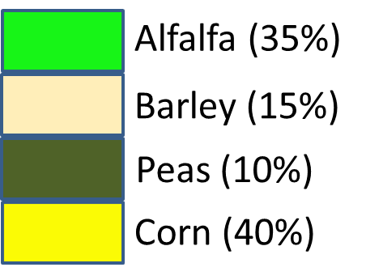
Material and Methods
The crop distribution pattern was presented on the left Figure. Crop distribution was similar for both simulation cases.
The comparison has been performed for a series of meteorological data from 2006 to 2014.

Slide 12
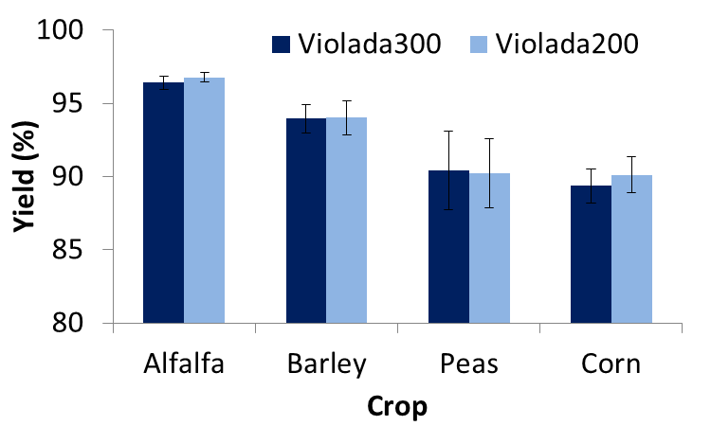
Results and Discussion
In general the average yield was larger for Violada200 than for Violada300, except for peas.
From an statistical point of view, the yields were not different between pressure treatments.

Slide 13
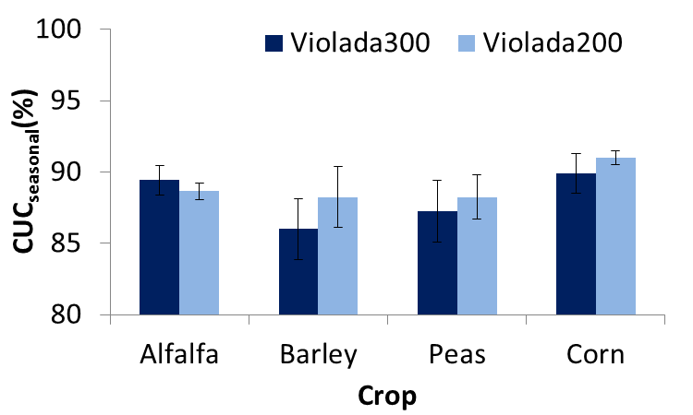
Results and Discussion
Seasonal uniformity coefficient resulted larger for Violada200 than for Violada300 for all crops except for alfalfa.
The differences resulted statistically significant for alfalfa, barley and corn.
Notes:
Larger irrigation time for Violada 200 compared to Violada 300, smouth the effect of irrigation uniformity

Slide 14
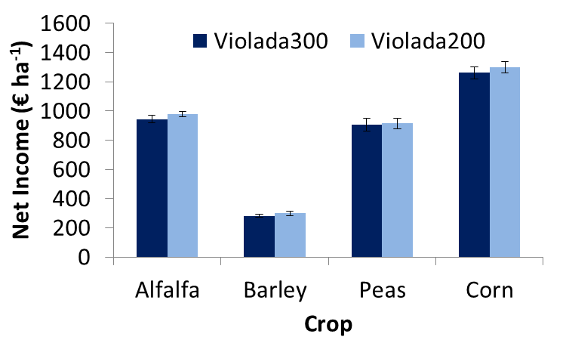
Results and Discussion
Net income in € ha⁻¹ (without including investment cost) resulted slightly larger for Violada200 than for Violada300 for all the analyzed crops.

Slide 15
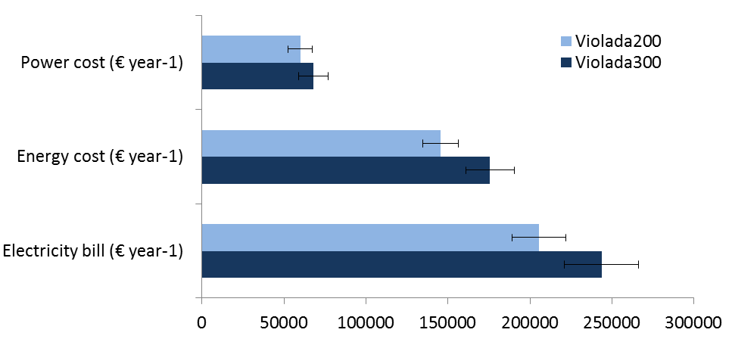
Results and Discussion
An average reduction of 11% in the power cost, 17% in the energy cost and 16% the electricity bill for the lowest pressure treatment (Violada200) was observed.

Slide 16
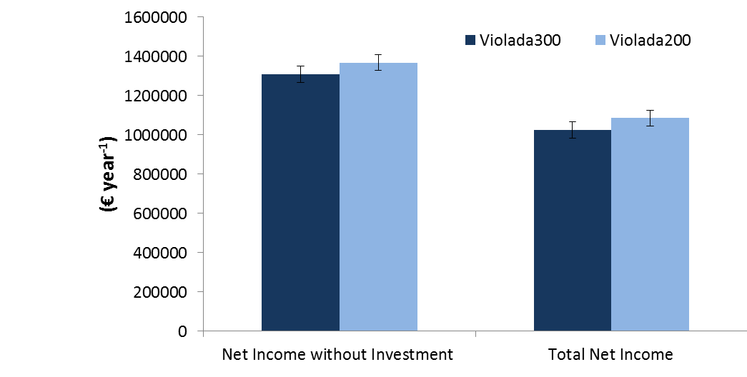
Results and Discussion
The total net income for the area including operational and investment cost showed larger income for the Violada200 pressure treatment than for Violada300.

Slide 17
Conclussions
The comparison of two irrigation network designs to operate at 300 or 200 kPa, respectively, for a time series of meteorological data in la Violada Irrigated area indicates that:
The lowest pressure design resulted in a slightly lower investment cost (both for the collective and the on-farm irrigation system) .
The yield for the principal crops was not affected when reducing the working pressure.
The increase in irrigation time for the lowest pressure option results in an increase on the seasonal irrigation performance index (CUC) for the analyzed crops.
The electricity consumption (power and energy) and its cost were significantly reduced. This reduction did not affect the net income of the analyzed crops.
For La Violada irrigated area the global numbers indicate that Violada200 designs provides larger productivity than Violada300.

